Slide 1
MSP x Delphi Capstone Progress Update
1 April 2022
Anirban Chowdhury, April Wang, Bhoomika Moorjani, Manna Zhao, Rosa Jin

Slide 2
Test positivity rate from CTIS and Quidel
Estimated test positivity rate (percent) among people tested for COVID-19 in the past 14 days (CTIS) & Percentage of antigen tests that were positive for COVID-19 smoothed by pooling together the last 7 days of tests (Quidel)
Percentage of positive NAAT in the past 7 days ( Community Profile Report)
COVID symptoms (sore throat) from CTIS and Google search
Estimated % of people reporting that they or someone in their household experienced a sore throat in the past 24 hours (CTIS)
Measures search volume for “sore throat” symptom (Google search)
Covid-related doctor visits from Change Healthcare(CHNG) and claims(Doctor-Visits)
Early Indicators on COVID related doctor visits
Analysis on correlation through time in six main states

Slide 3





The Team
Manna (Xiangman) Zhao
Bhoomika Moorjani
Rosa (Zixuan) Jin
April (Yueni) Wang
Anirban Chowdhury

Slide 4
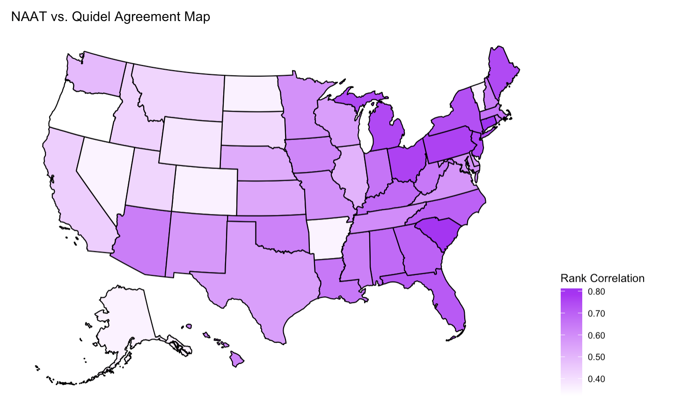
Test Positivity Rate:
NAAT vs Quidel
More agreement in the East
Less agreement in the Northwest

Slide 5
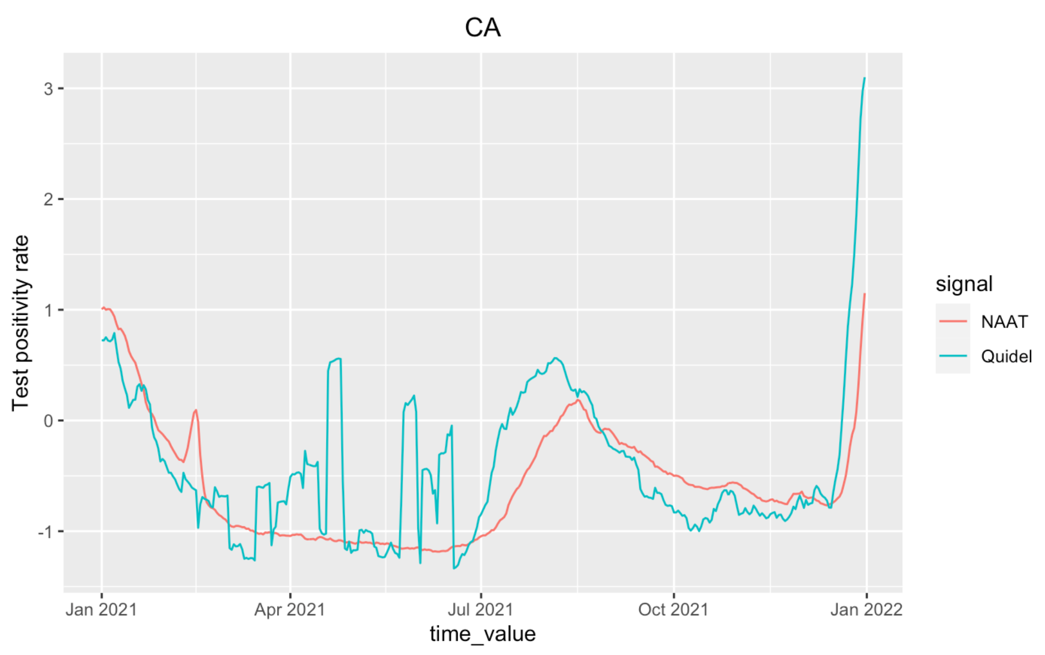
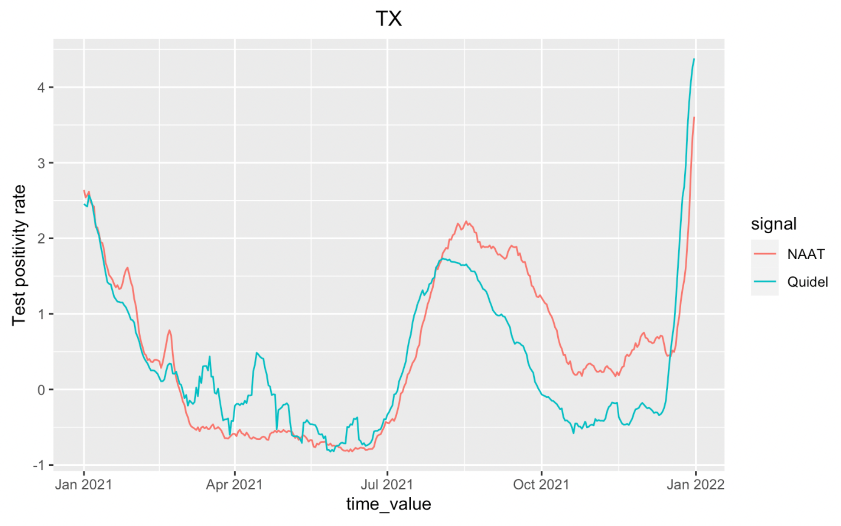
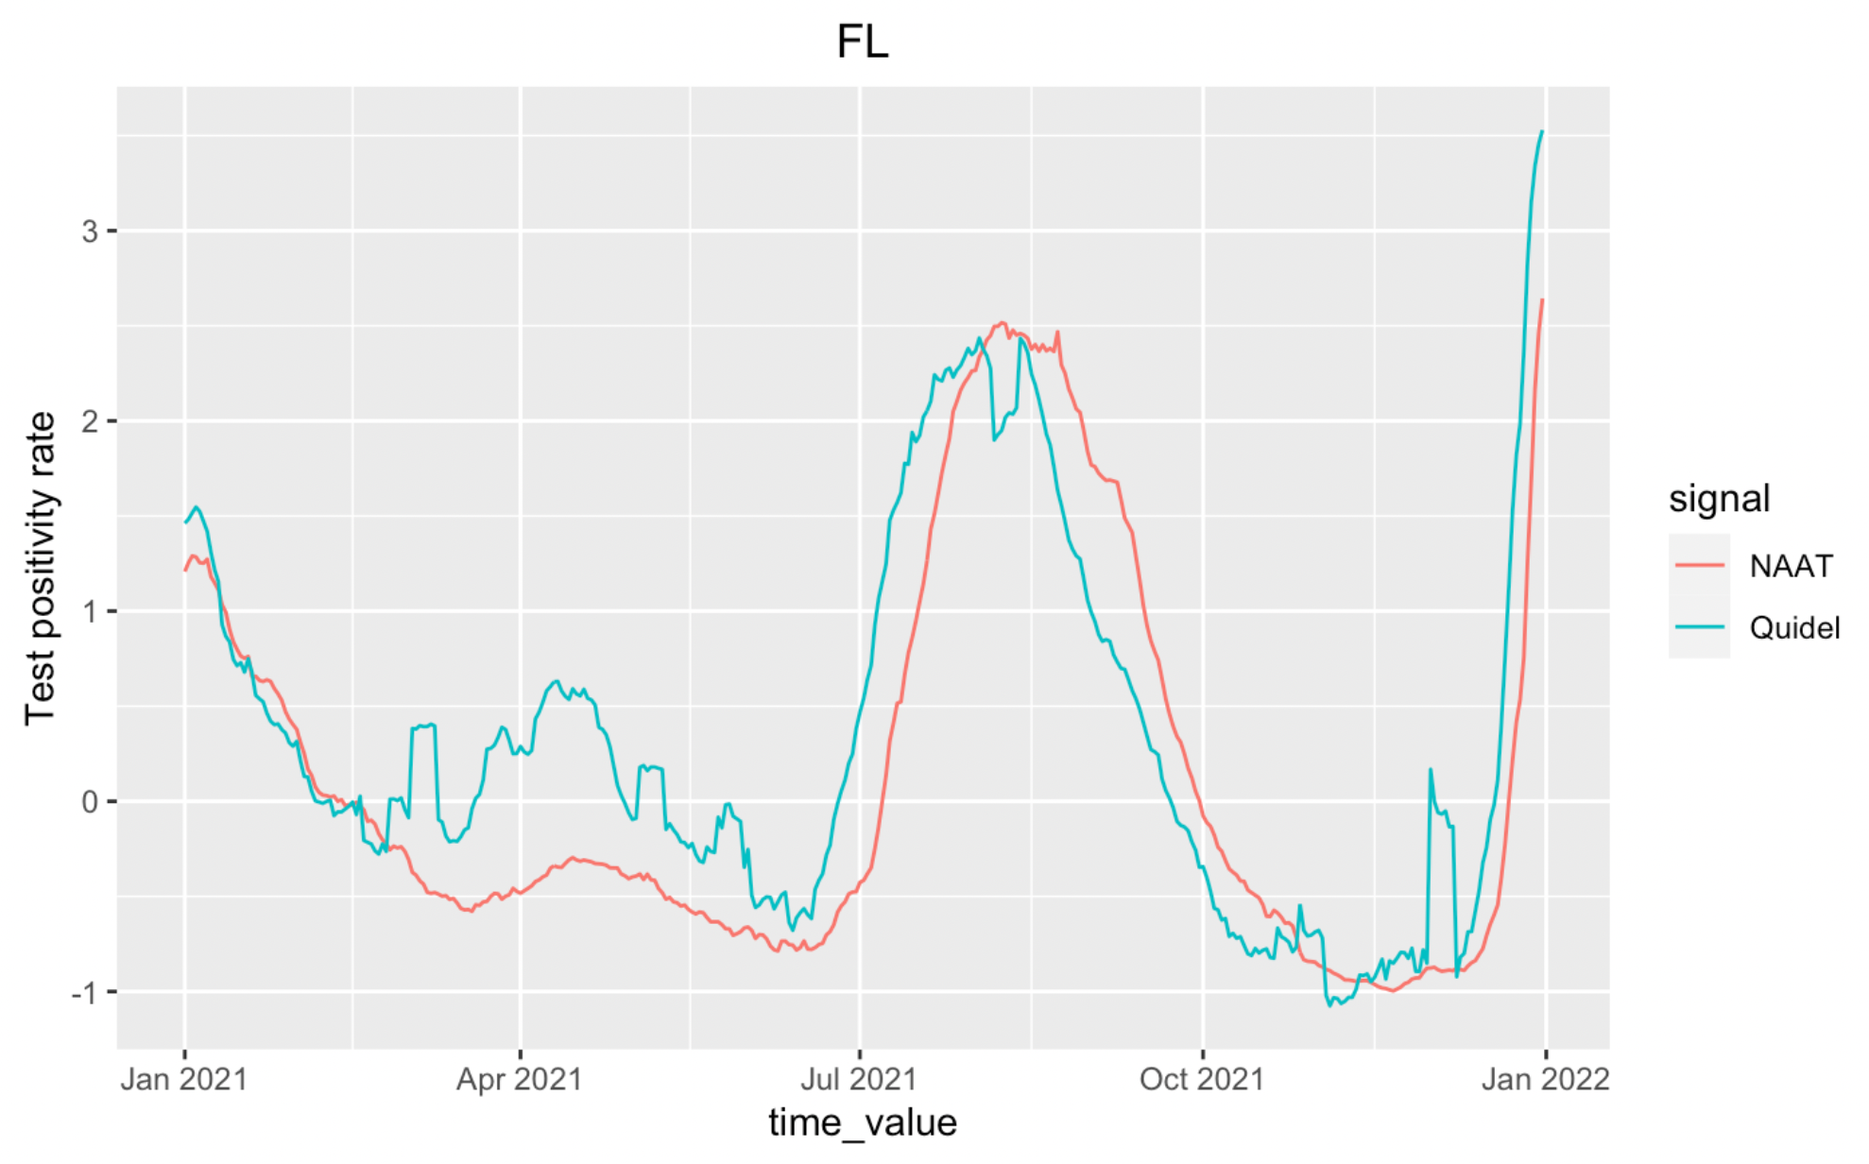
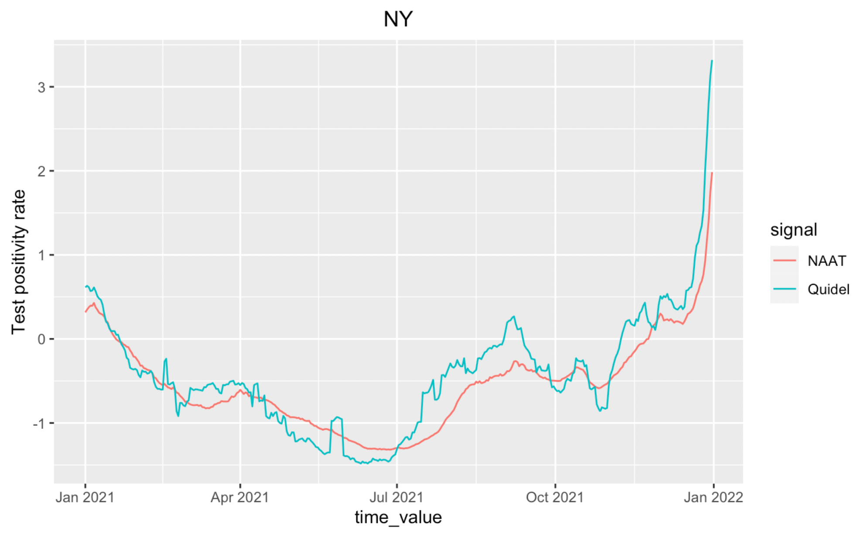
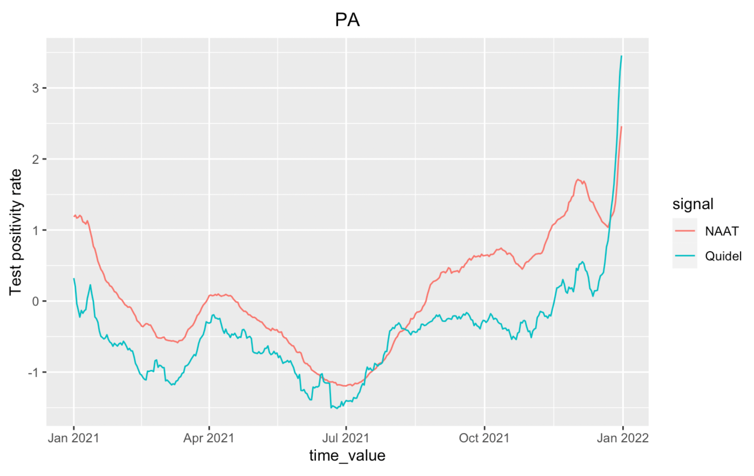
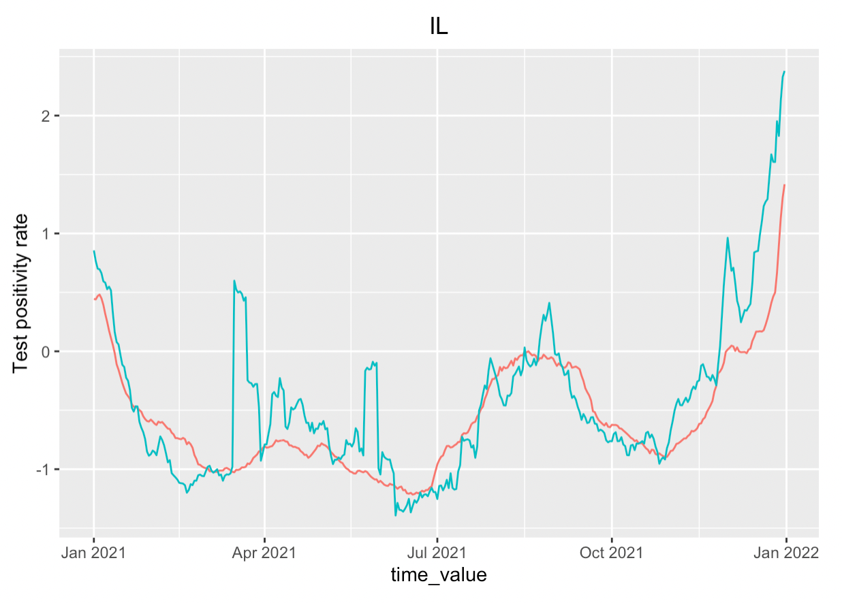
Test Positivity Rate:
NATT vs Quidel

Slide 6
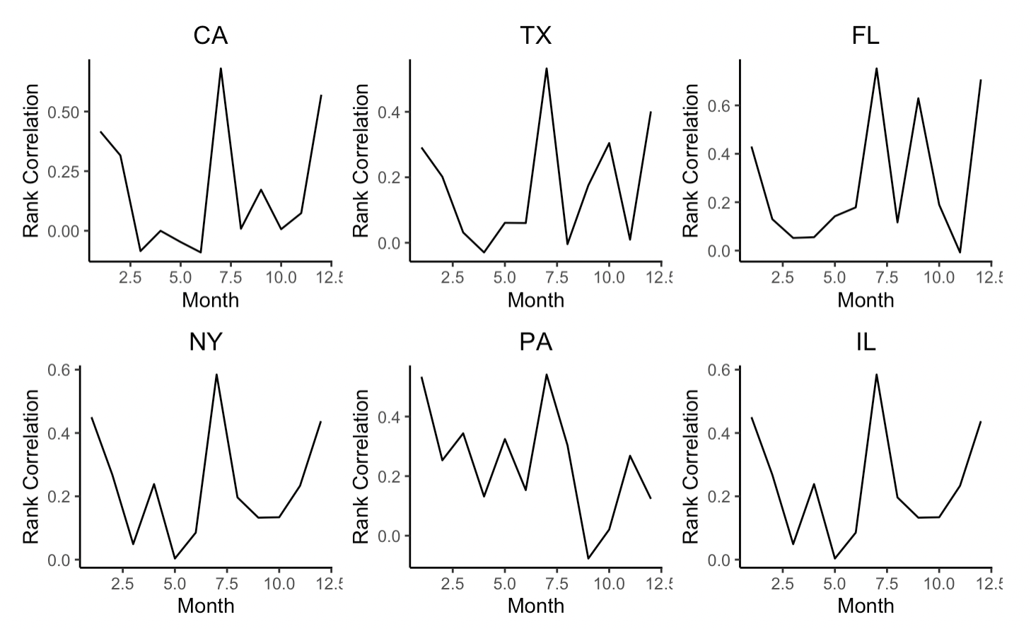
Spearman correlations : NAAT vs Quidel
Correlations across months between Jan 2021 to Dec 2021
Monthly segment
High correlations around July

Slide 7
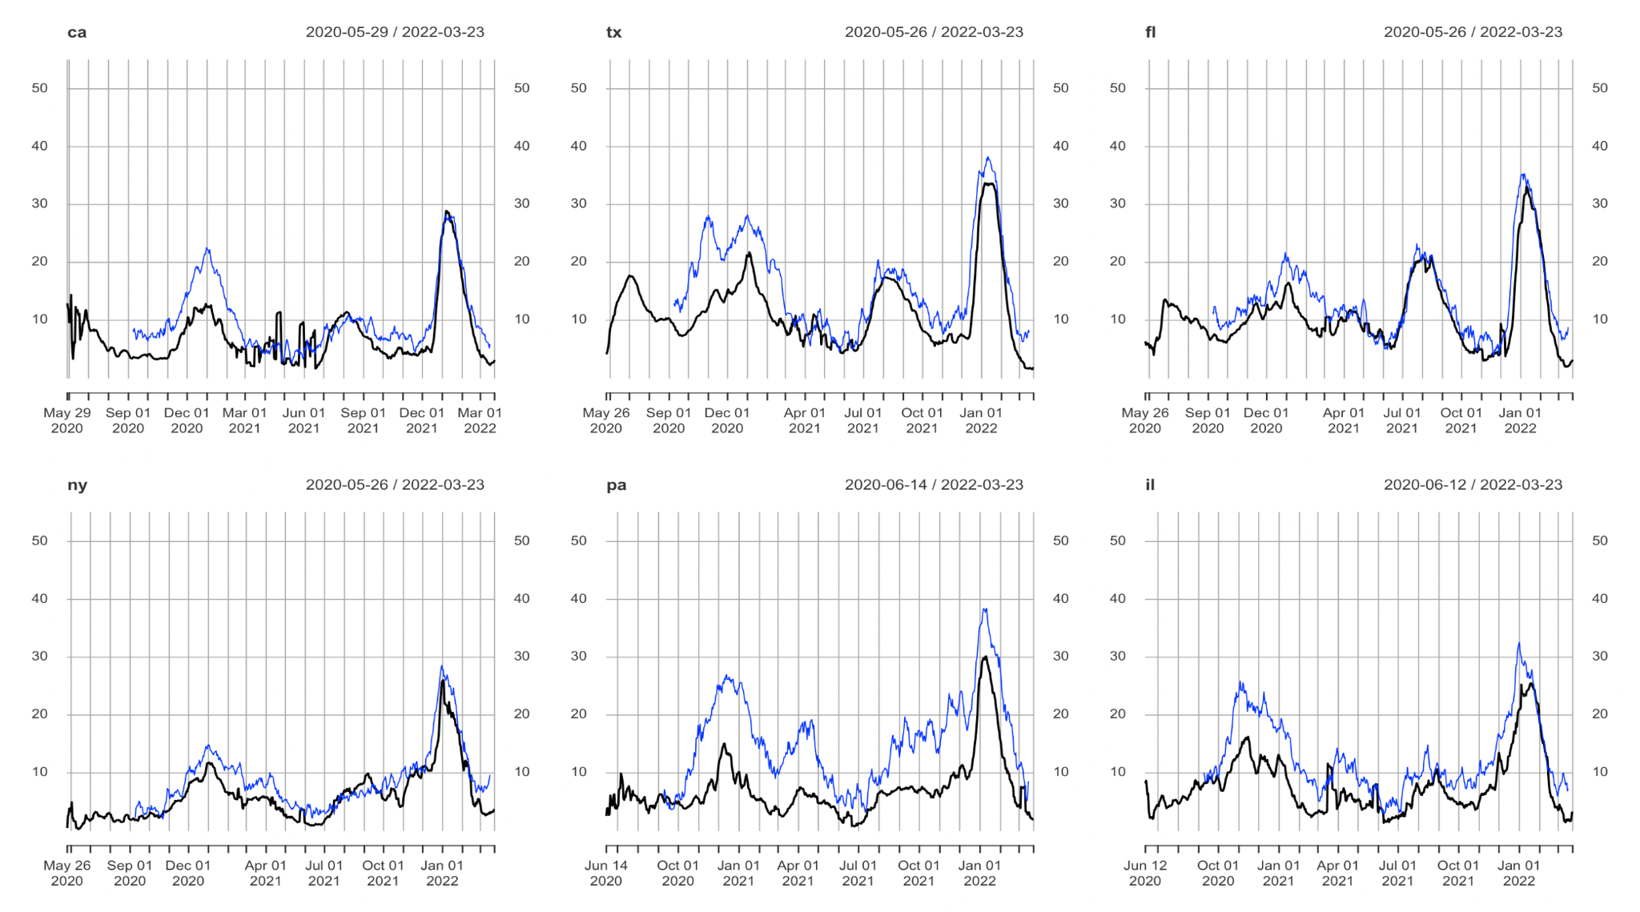
Test Positivity Rate : CTIS vs Quidel
CTIS - Estimated test positivity rate (percent) among people tested in the past 14 days (lagged by 10 days).
Quidel - Percentage of antigen tests that were positive smoothed by pooling together the last 7 days of tests.

Slide 8
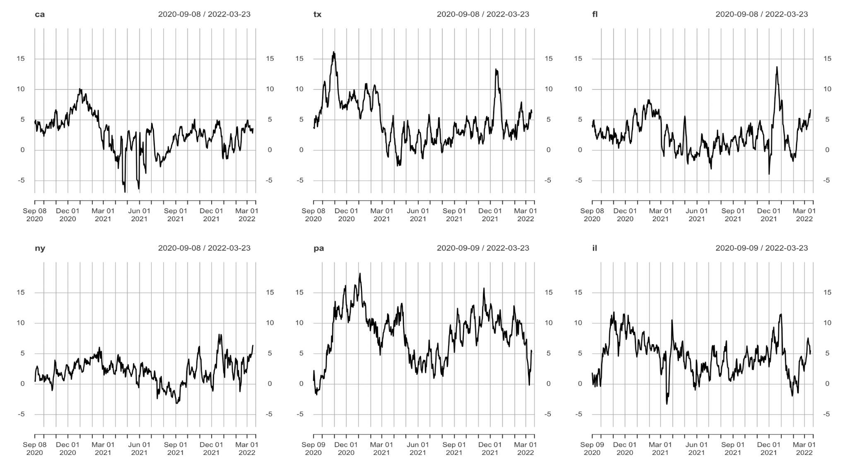
Degree of retesting : CTIS - Quidel
Difference between test positivity rate from CTIS (lagged by 10 days) and Quidel

Slide 9
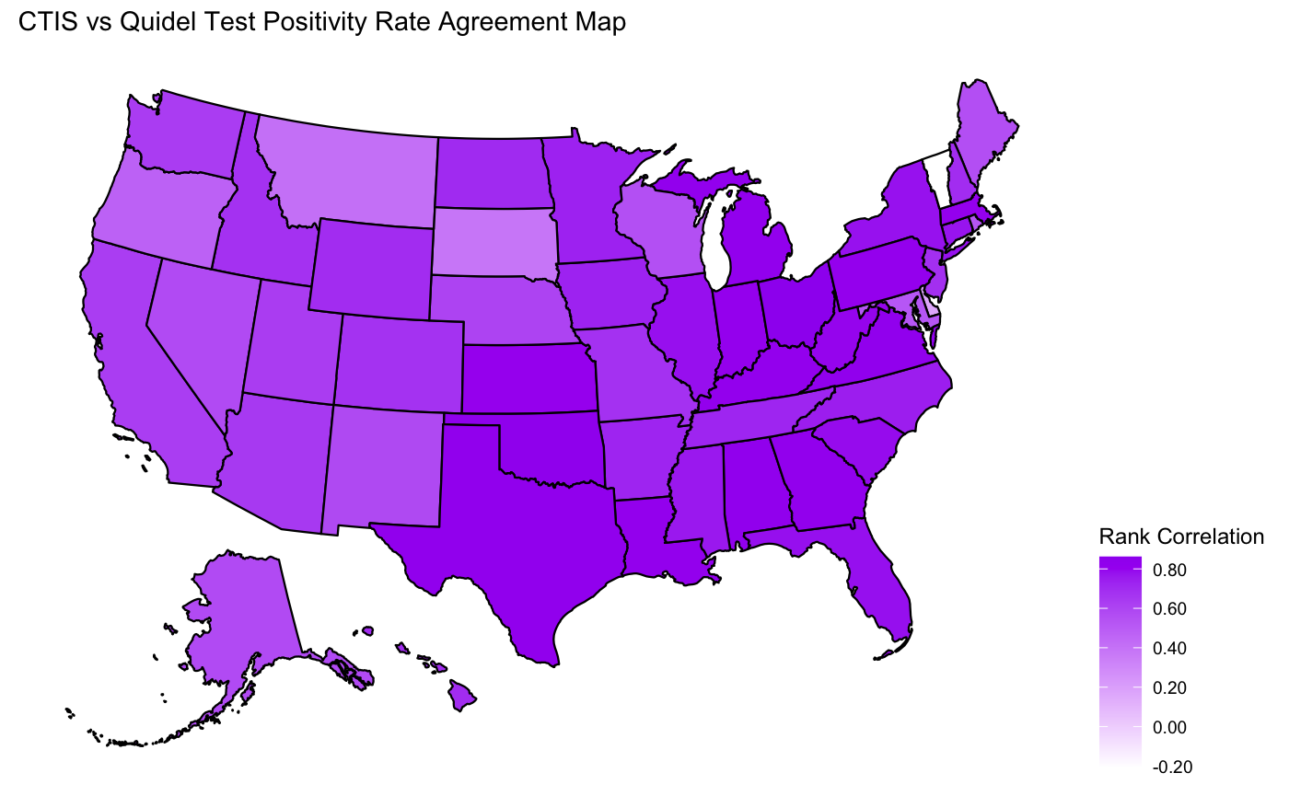
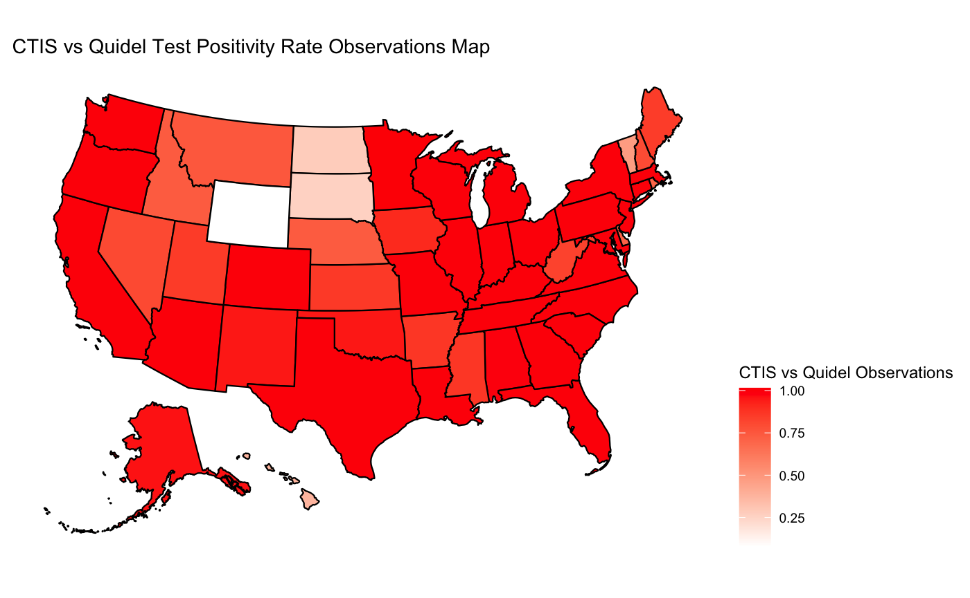
Test positivity rate: CTIS vs Quidel
Spearman correlation
Ratio (CTIS observations / Quidel observations)

Slide 10
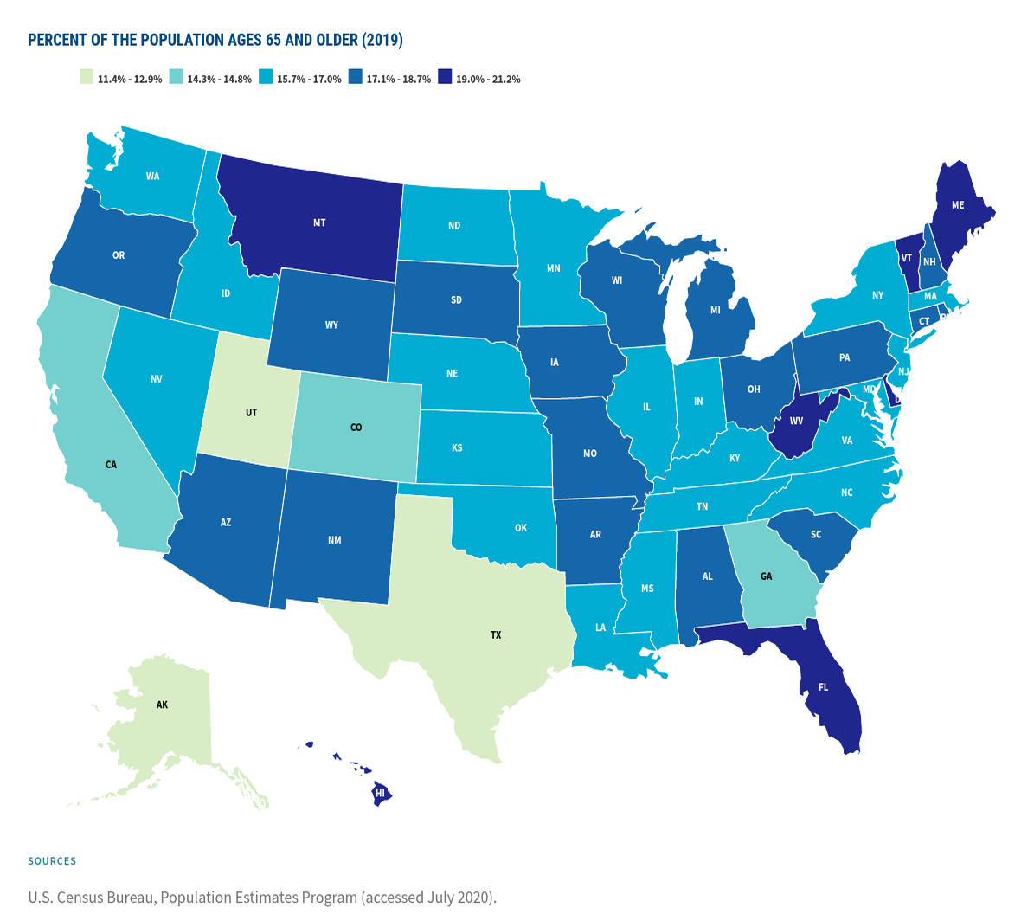
Test positivity rate: CTIS vs Quidel
Spearman correlation
Percent of population of aged 65 and above (2019)

Slide 11
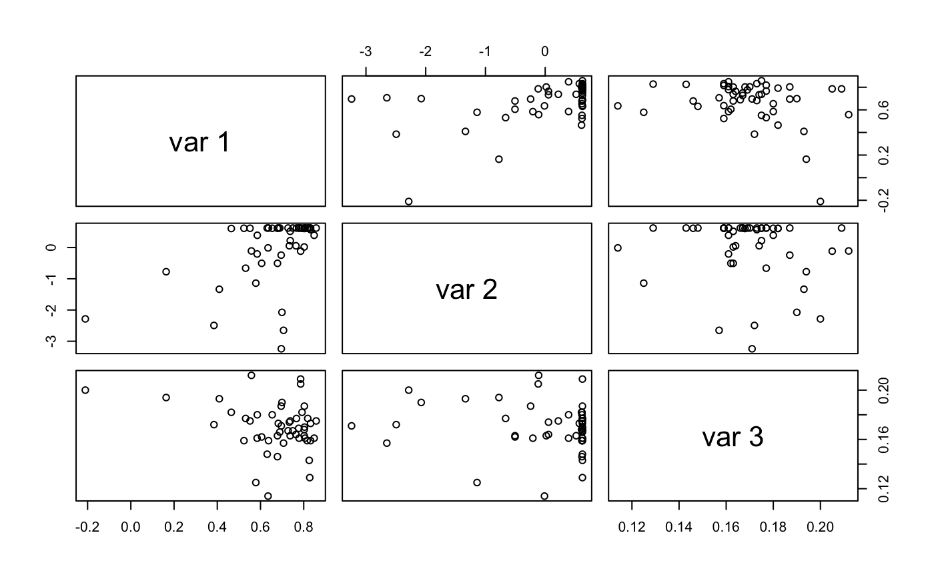
Test positivity rate: CTIS vs Quidel
var 1: Spearman correlations across states
var 2: scaled CTIS observations [0, 1]
var 3: Population percentage of aged 65 and above

Slide 12
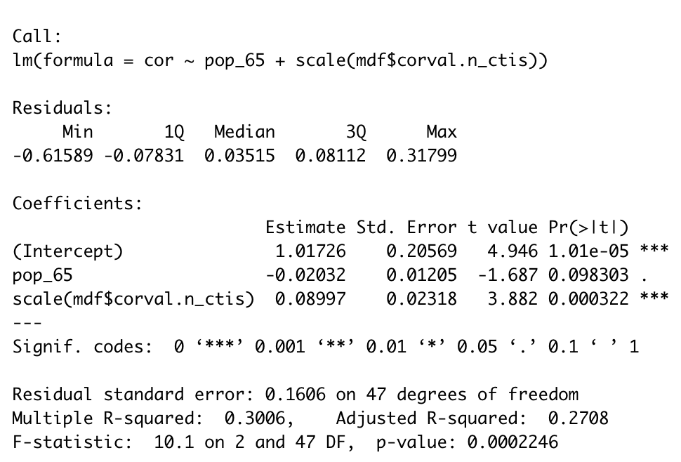
Test positivity rate overall: CTIS vs Quidel
Positive association: CTIS observations & Spearman Correlation
Low Spearman correlation: could be missing values in CTIS

Slide 13
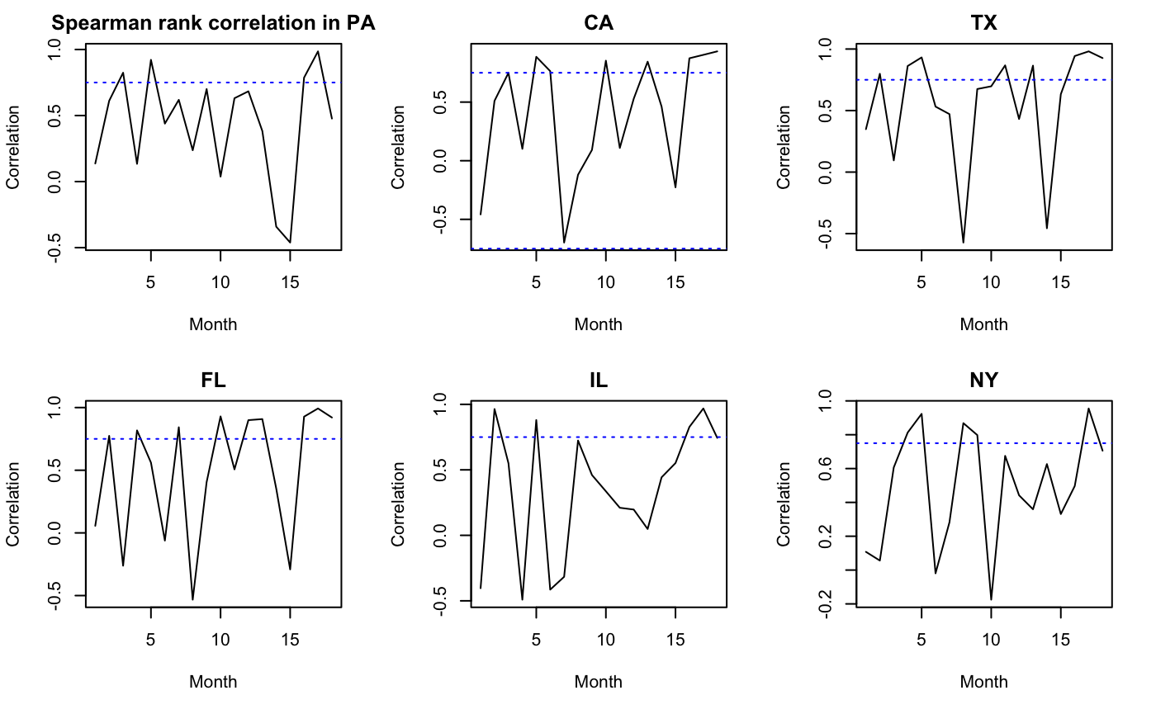
Spearman correlations : CTIS vs Quidel
Correlations across months starting Sep. 2020
Monthly (30 days) segment: Month 5 (Jan - Feb 2021)
High correlations: during outbreaks

Slide 14
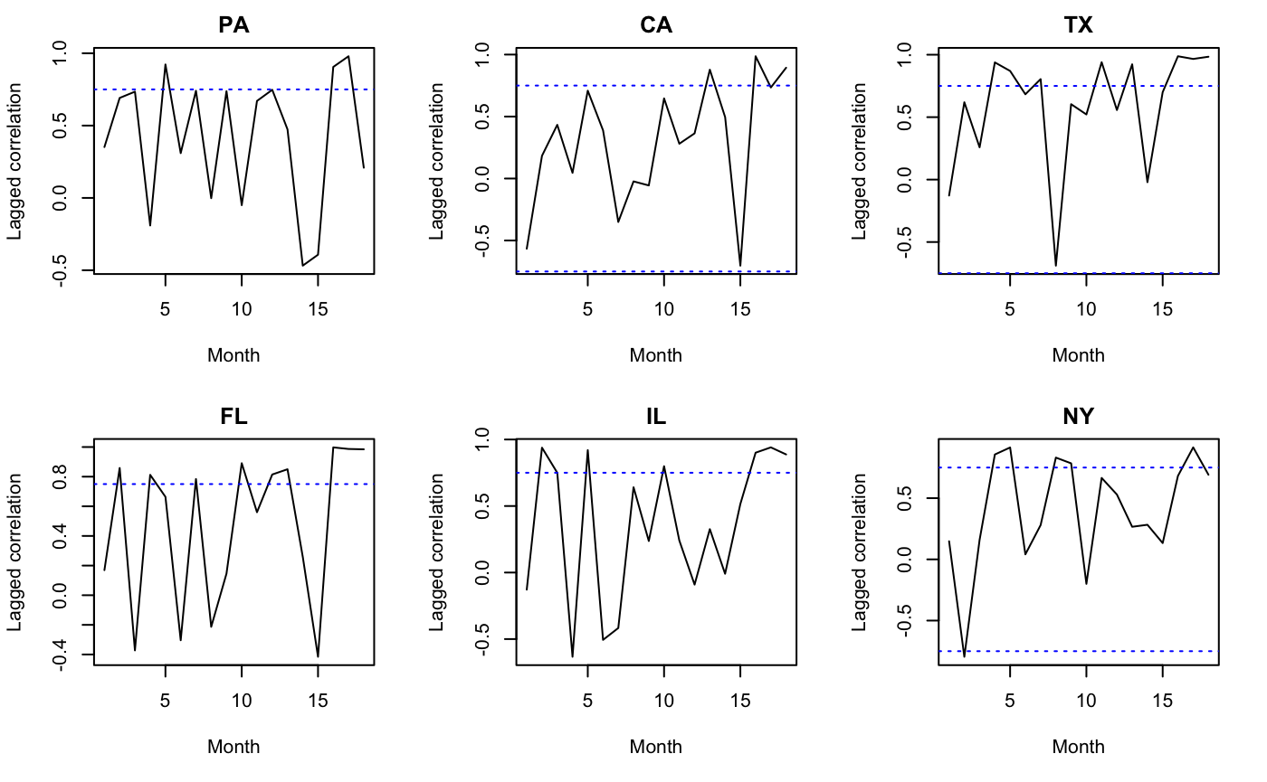
Lagged Spearman correlations : CTIS vs Quidel
Lagged correlations across months starting Sep. 2020
Lags: depending on cross-correlations

Slide 15
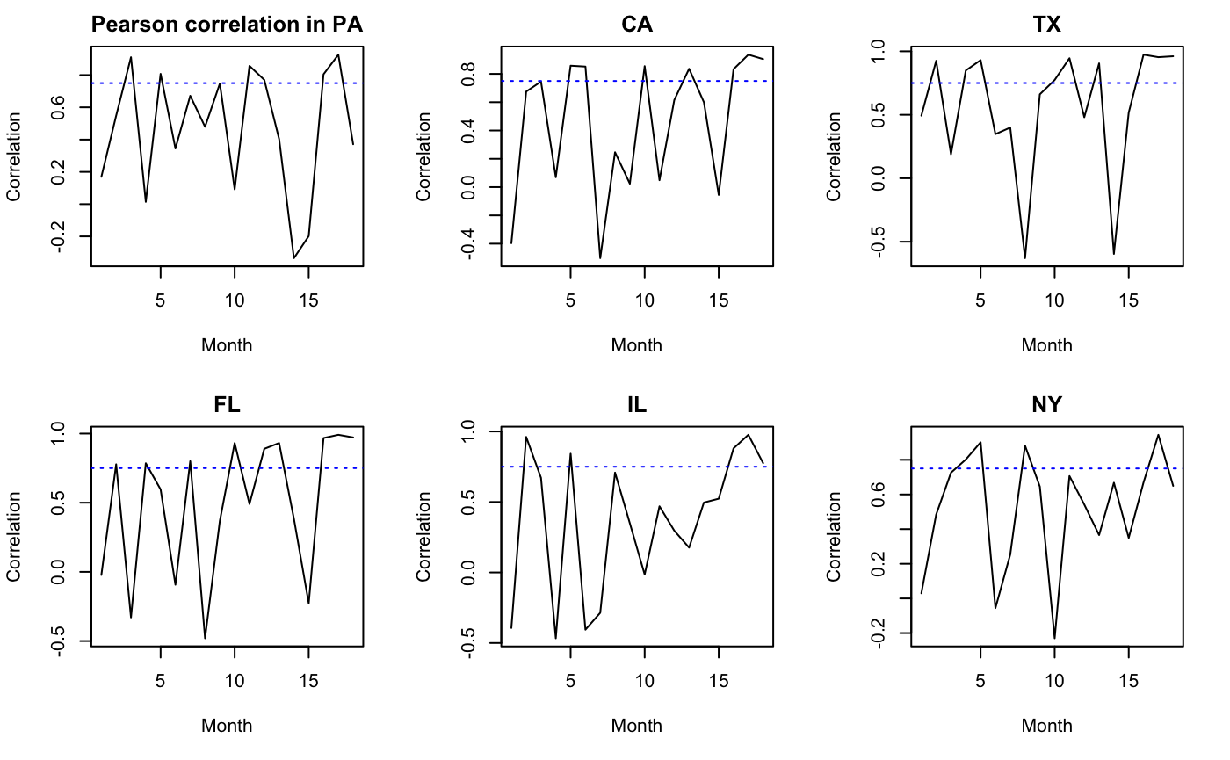
Pearson correlations : CTIS vs Quidel
Pearson correlations across months starting Sep. 2020
Monthly (30 days) segment: Month 5 (Jan - Feb 2021)
Similar to Spearman correlations

Slide 16
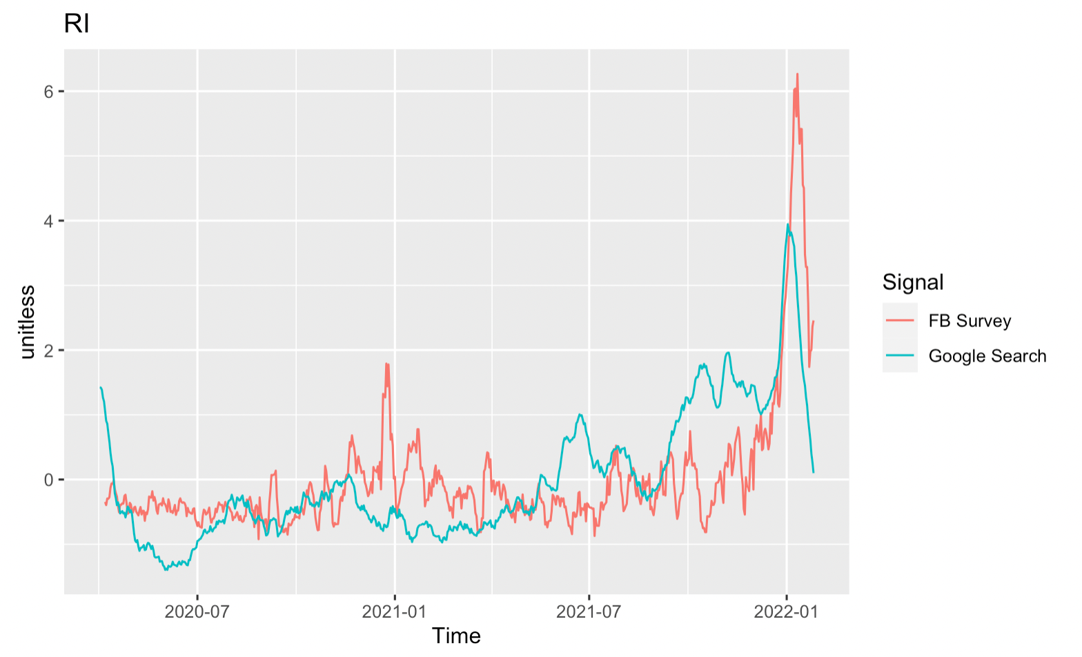
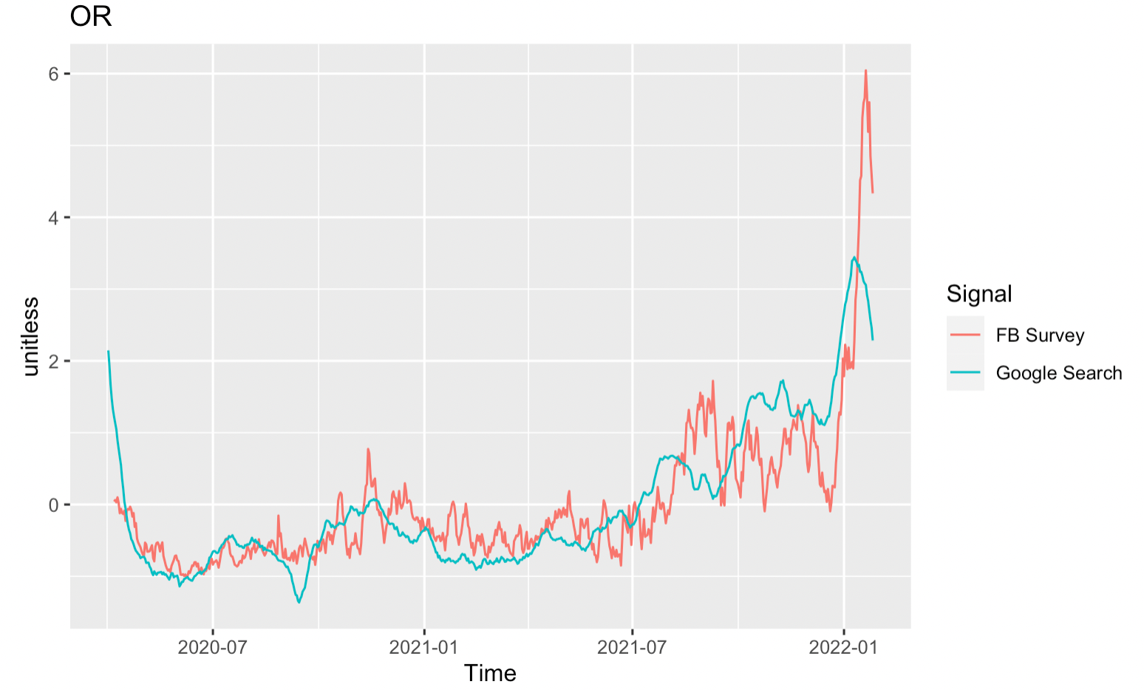
Correlation over Space:
Google vs Facebook
Signal Comparison in states with least (RI) and most (OR) agreement

Slide 17
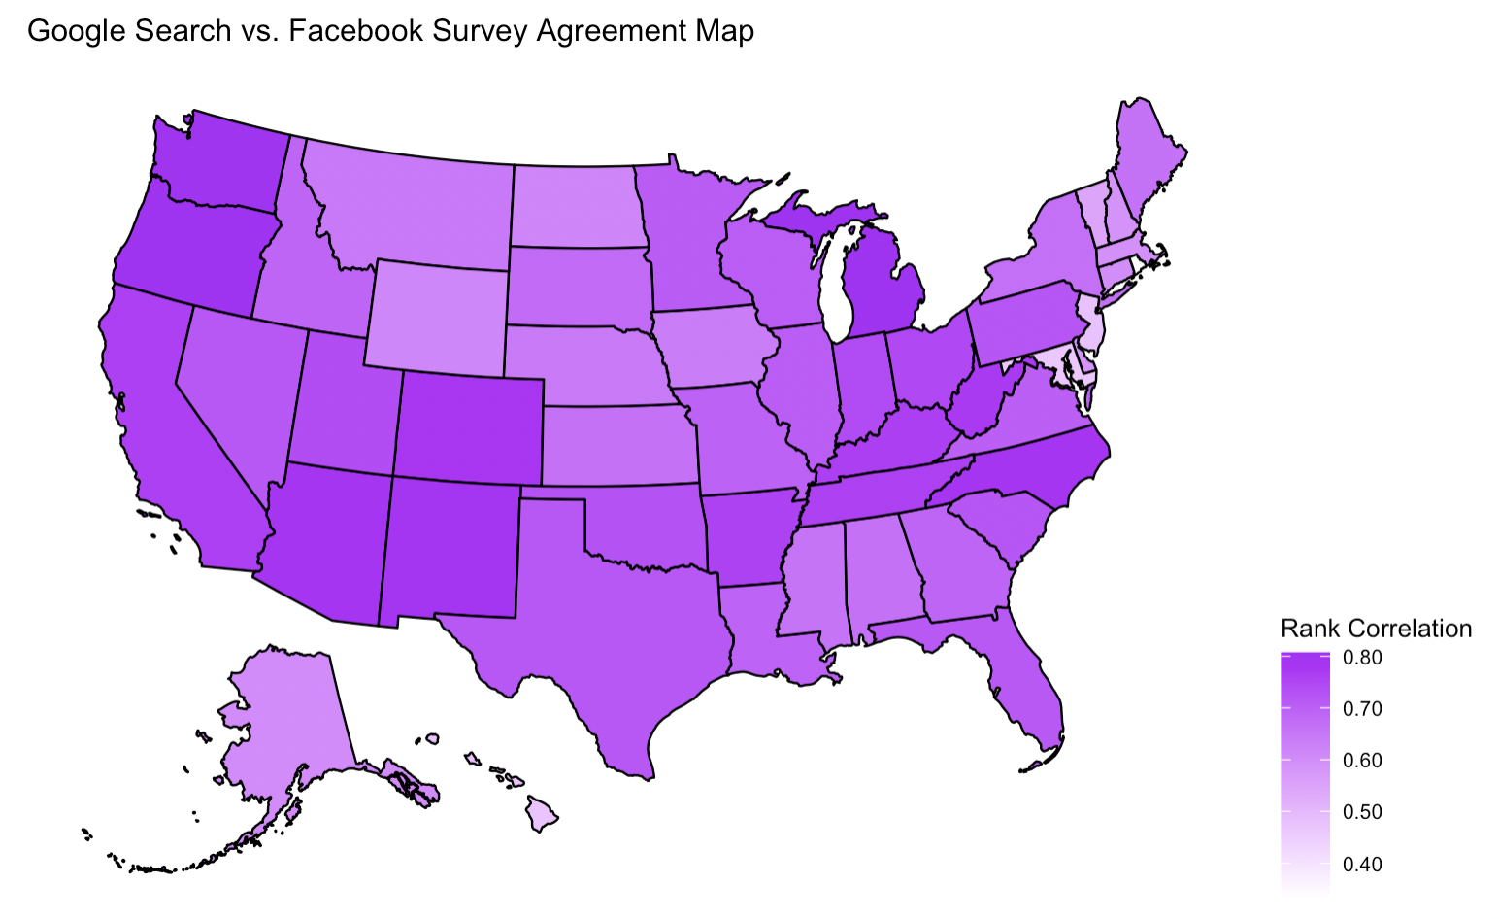
Correlation over Space:
Google vs Facebook
Less agreement in New England / Midwest
More agreement in Northwest / Central
Possible Reasons
Different demographics
Digital Media Habits
Temporal relationship with progress of pandemic

Slide 18
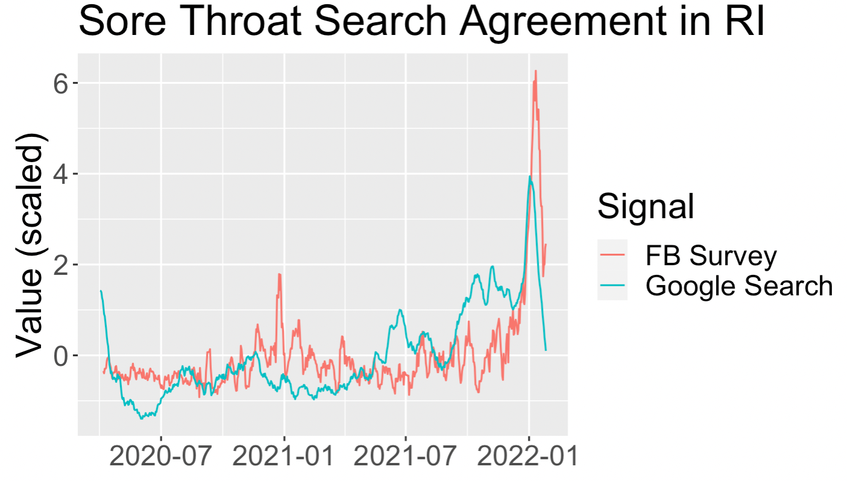
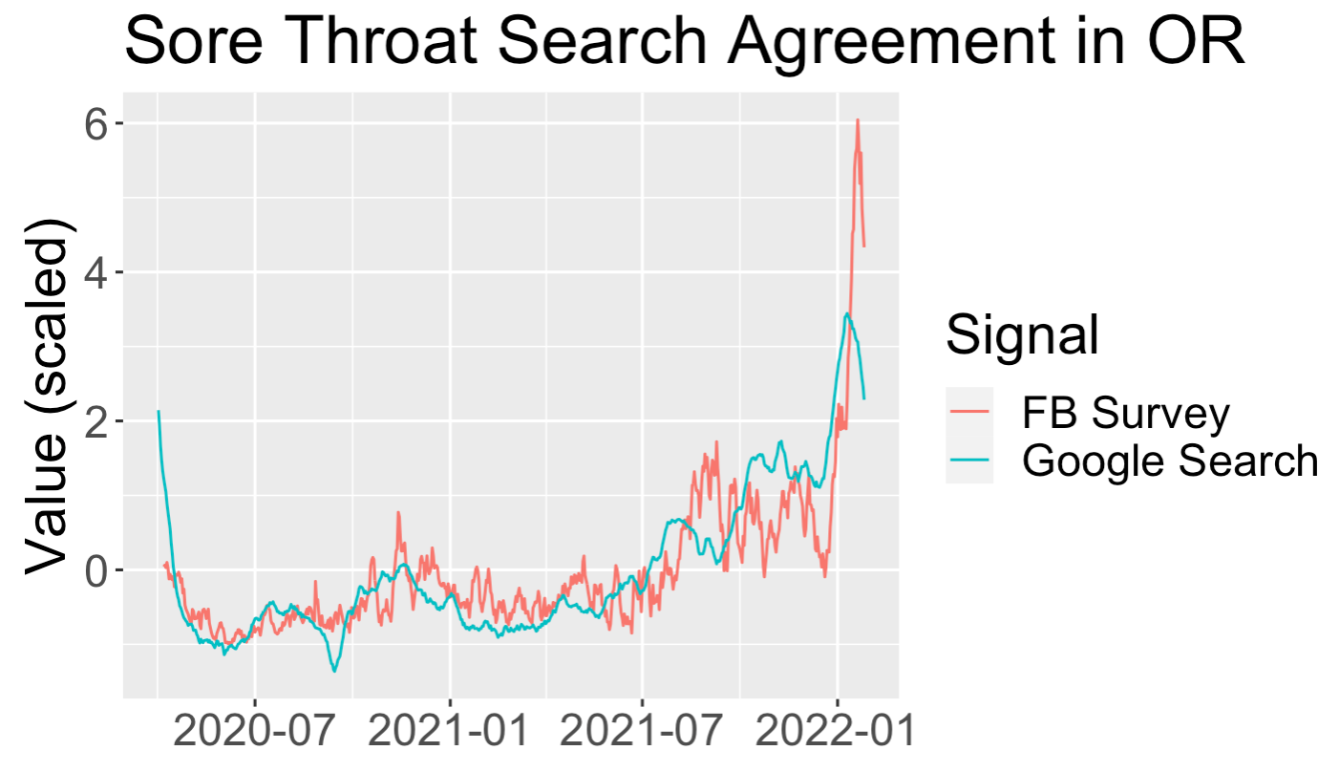
Data Source Agreement Varies depending on Location
OR
RI

Slide 19
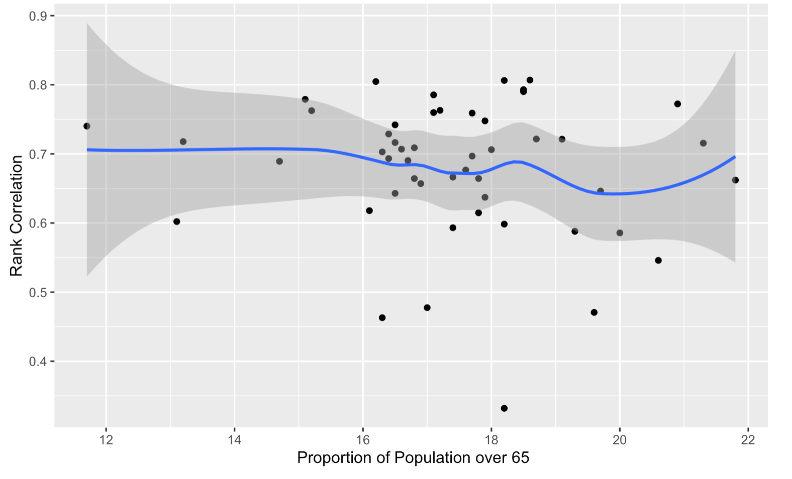
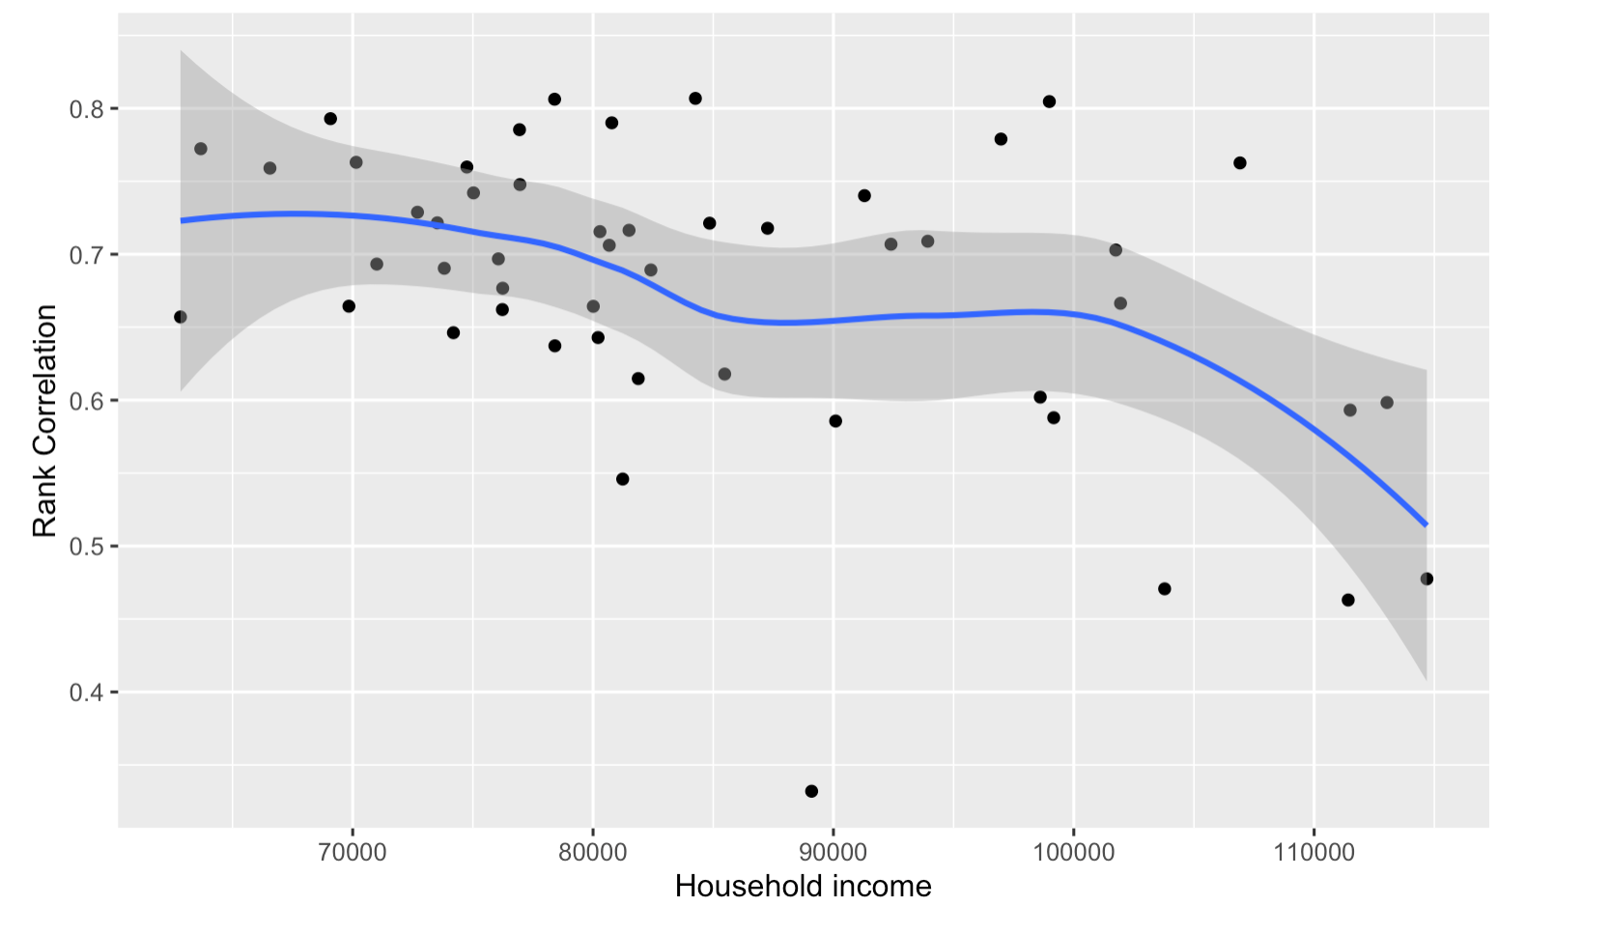
Investigating Reasons for Google / Facebook Disagreement
Rank Correlation vs Demographic Information

Slide 20
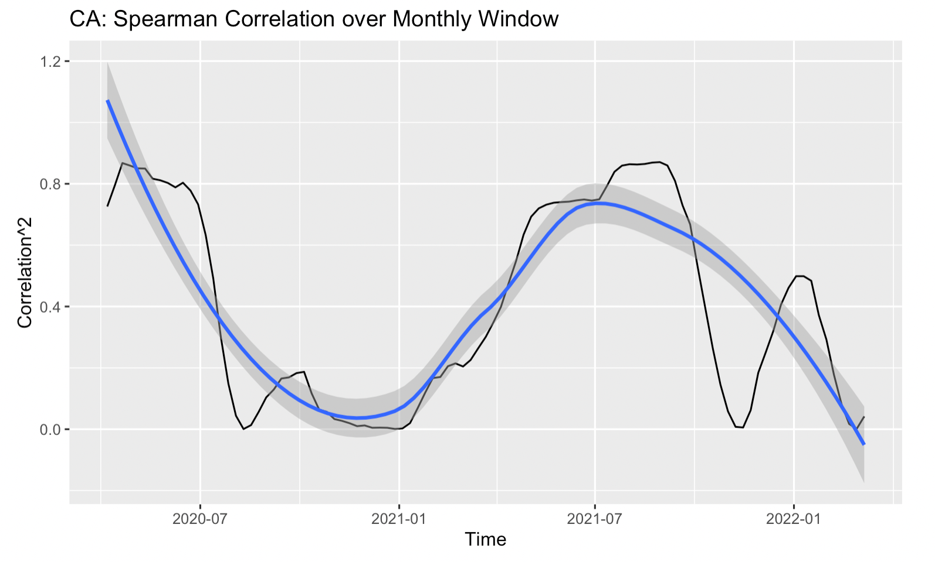
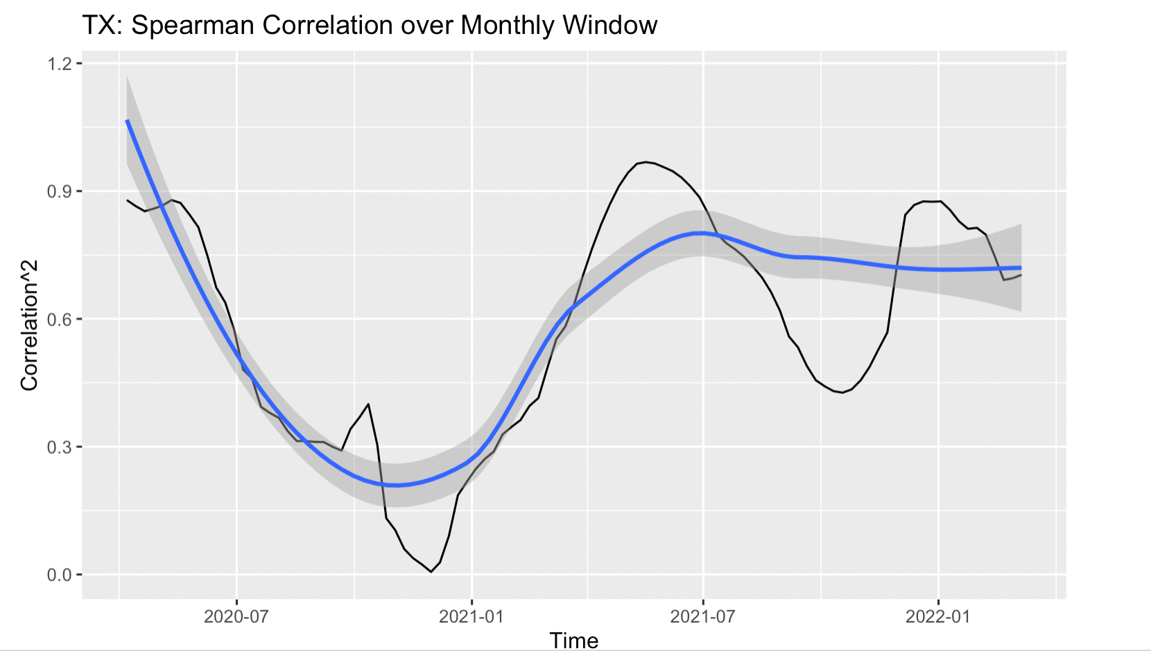
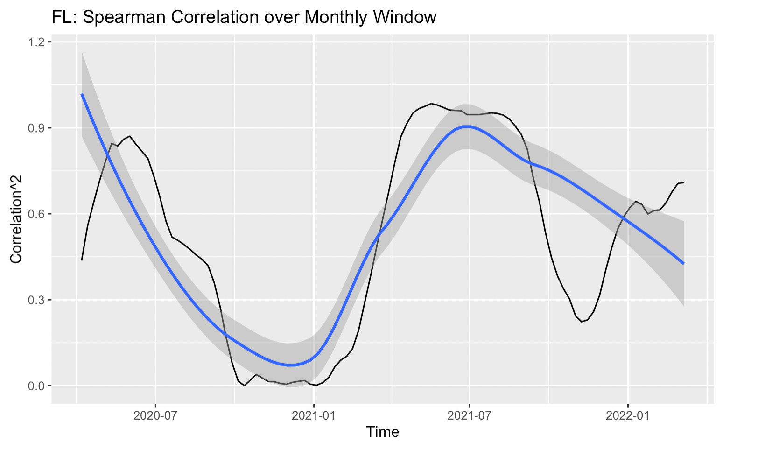
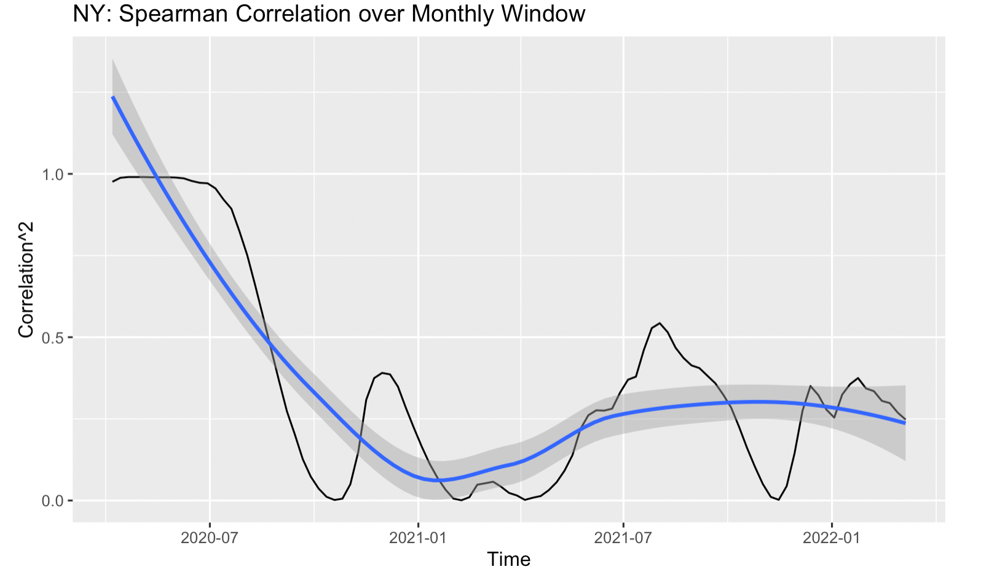
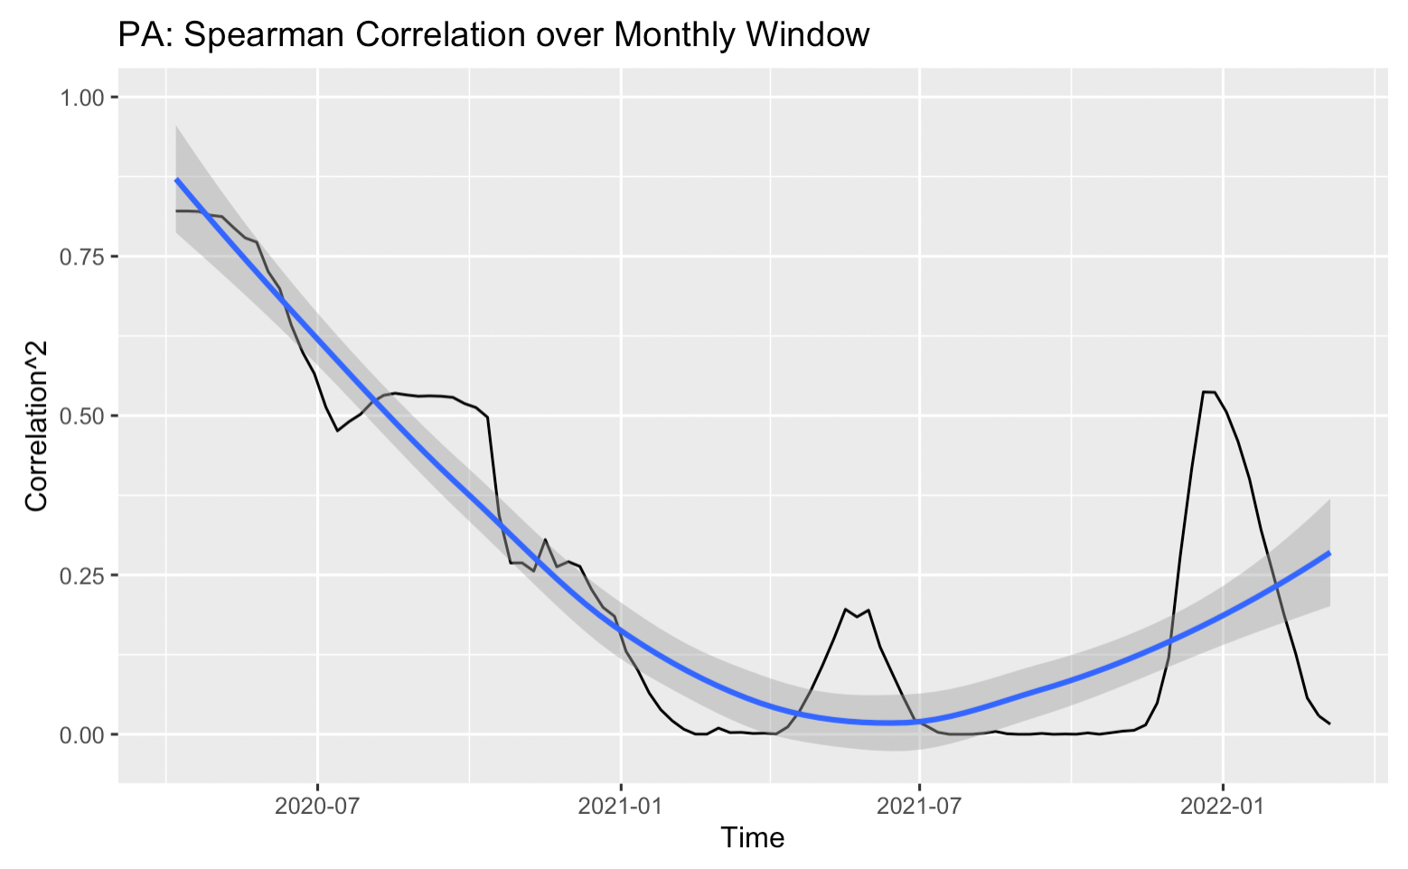
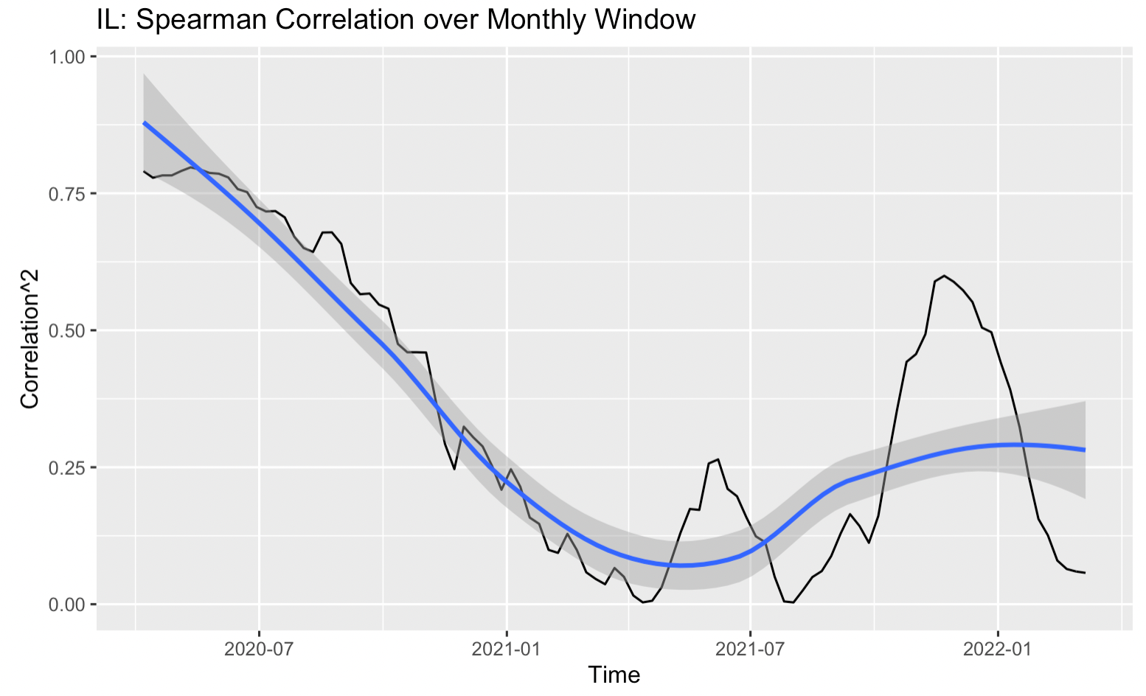
Correlation over Time:
Google vs. Facebook
31 Day moving window
Rank Correlation
Differs greatly by state
(Roughly) high correlation around outbreaks
Spring 2020
Summer 2021

Slide 21
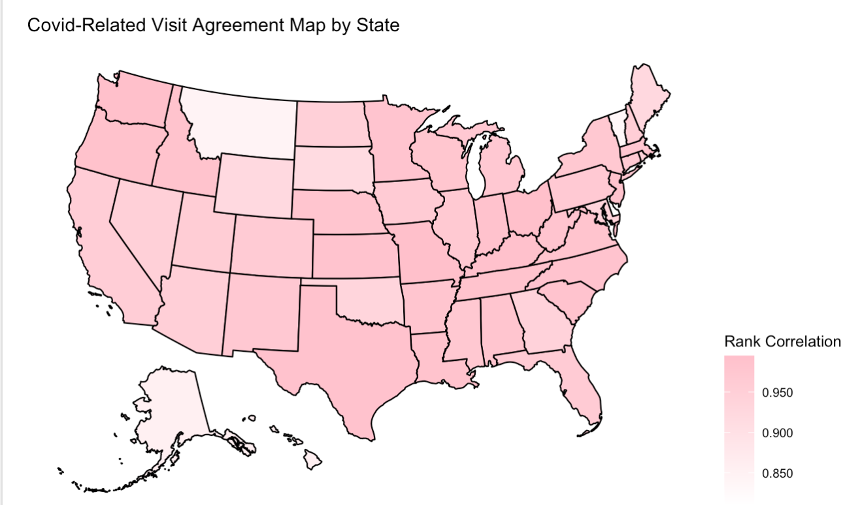
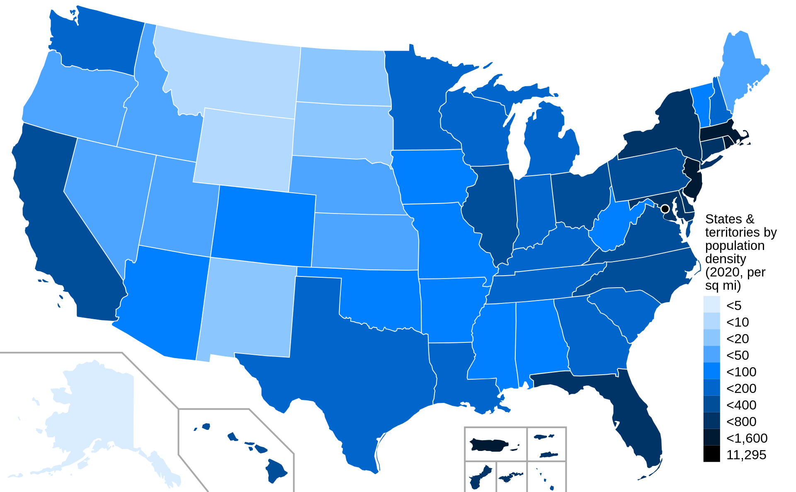
Correlation Over Space:Covid-Related Visits from Change Healthcare and Claims
US State Population Density
Higher agreement in southern and western US where population density is large
Lower agreement in northern US where population density is small

Slide 22
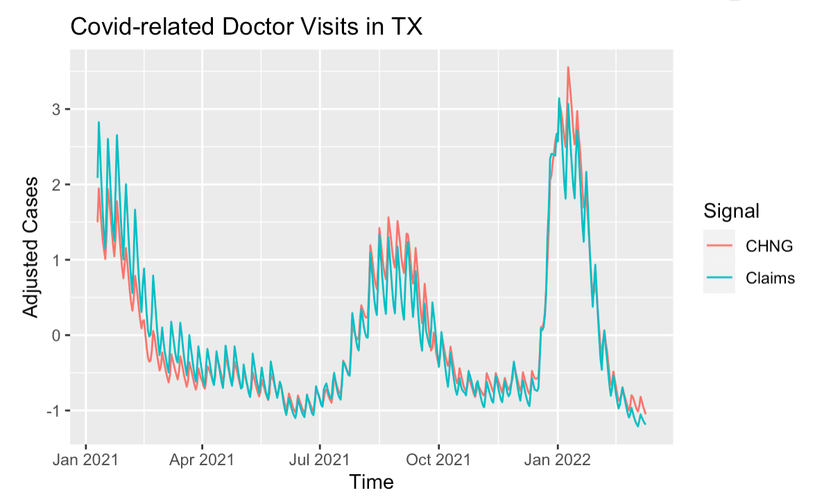
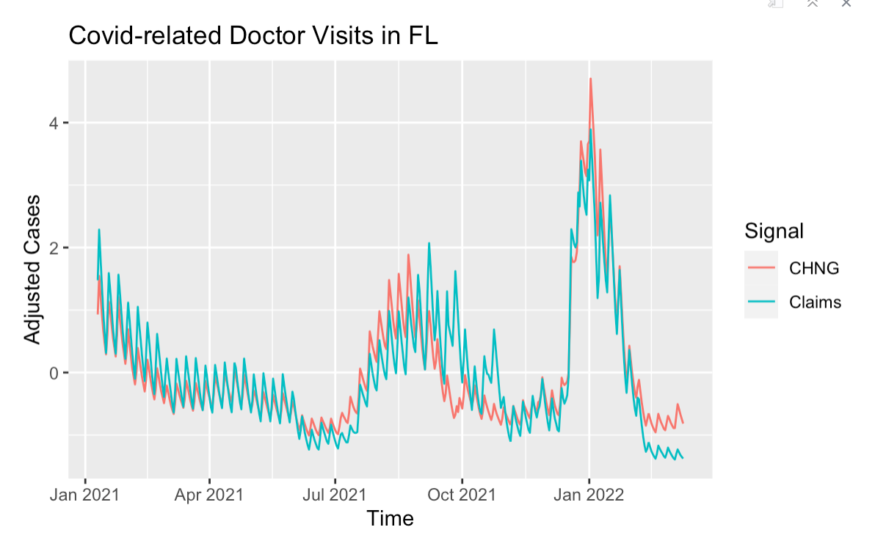
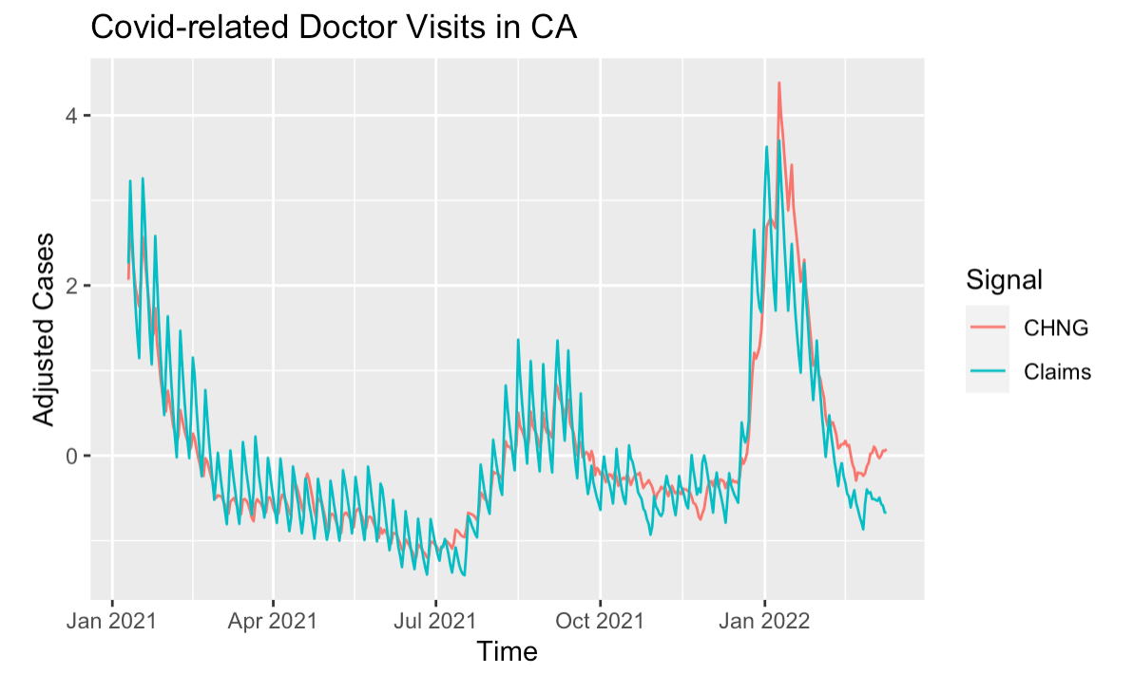
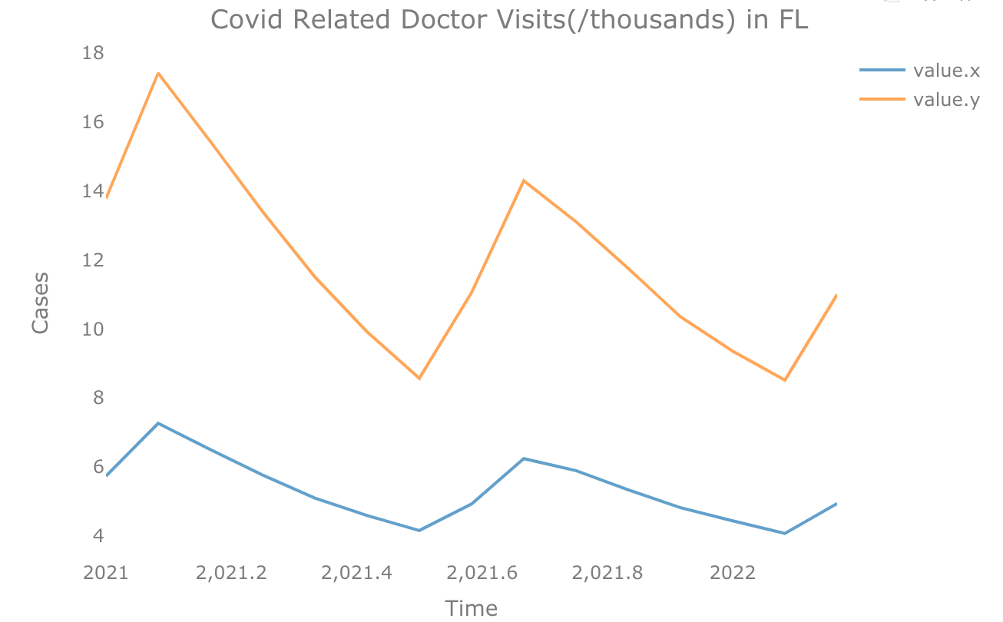
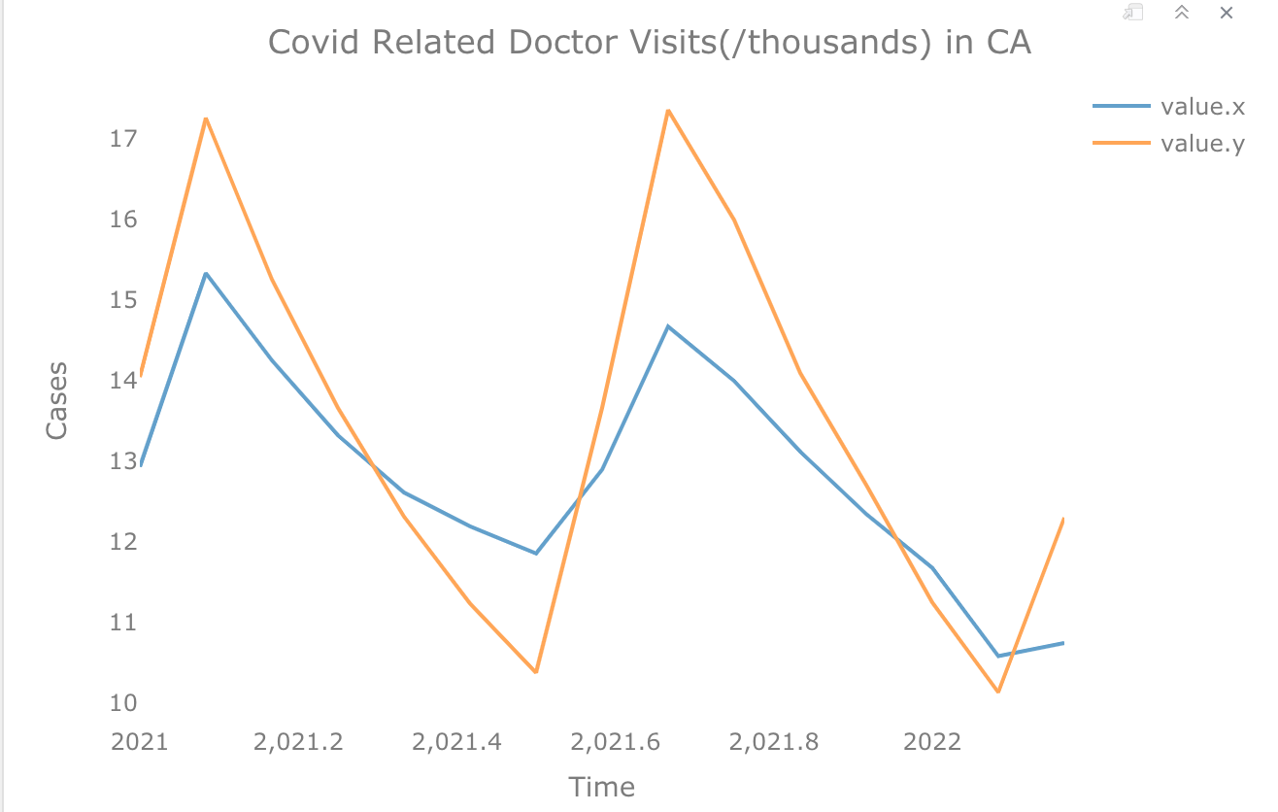
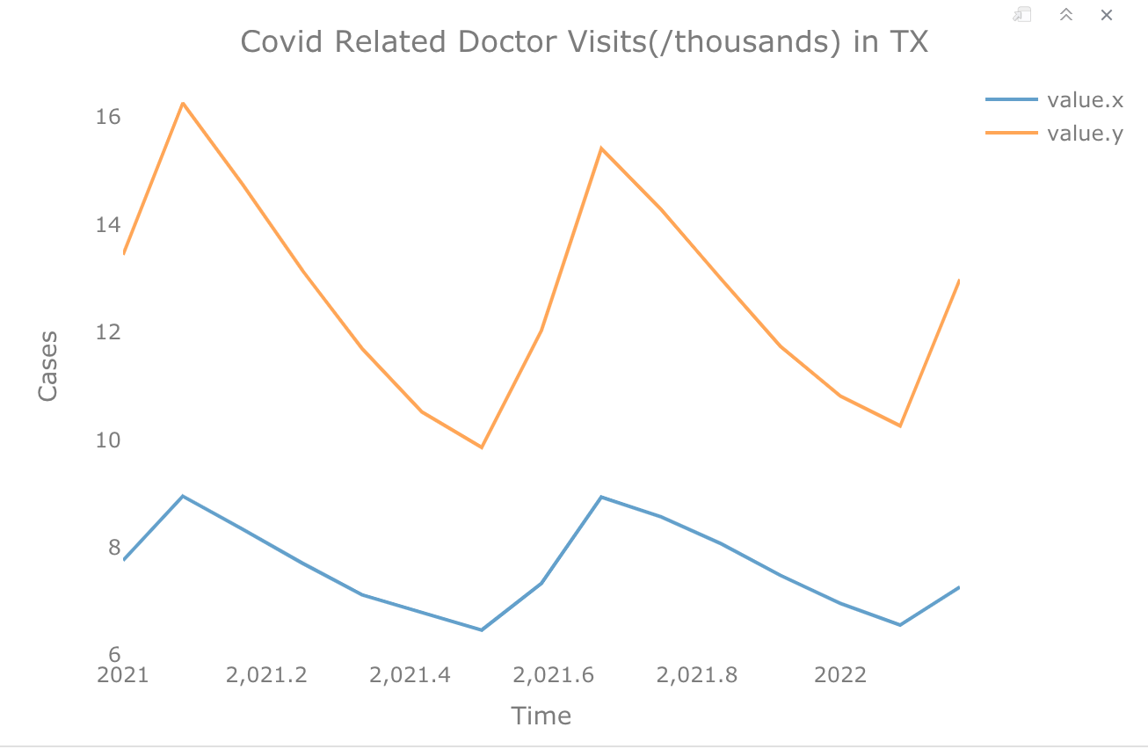
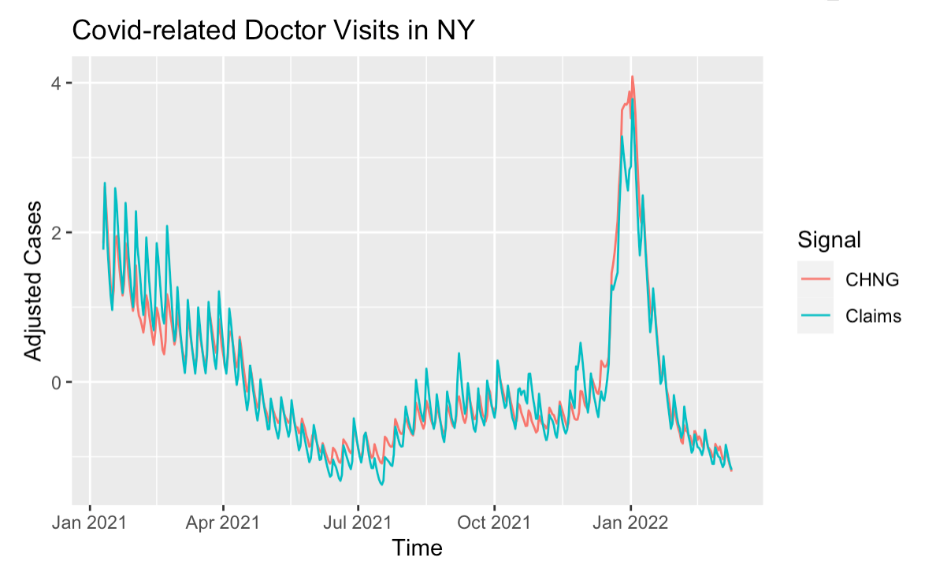
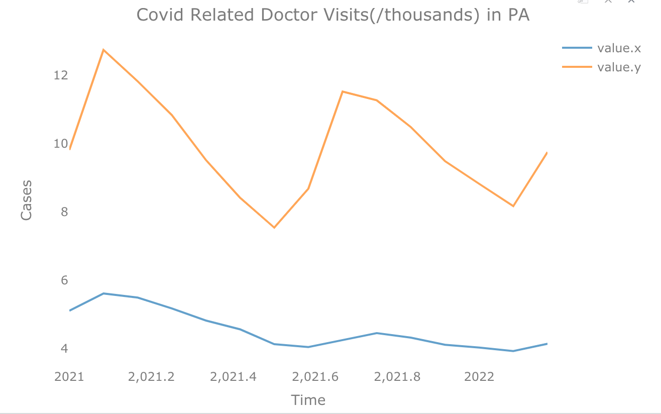
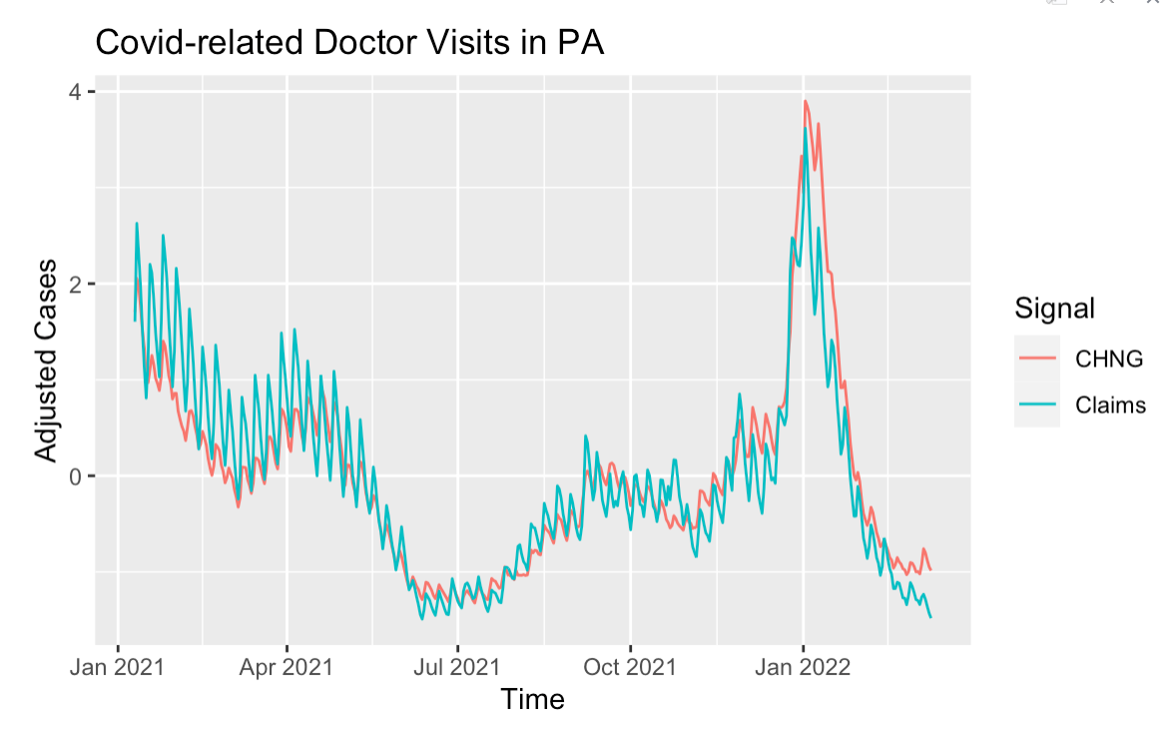
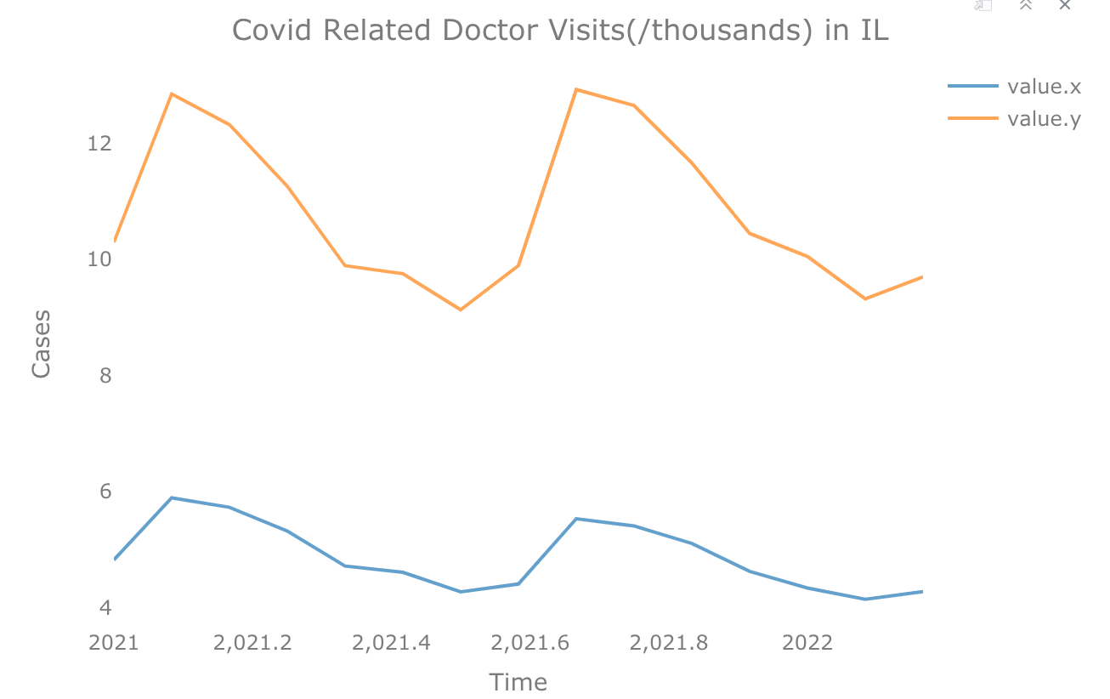
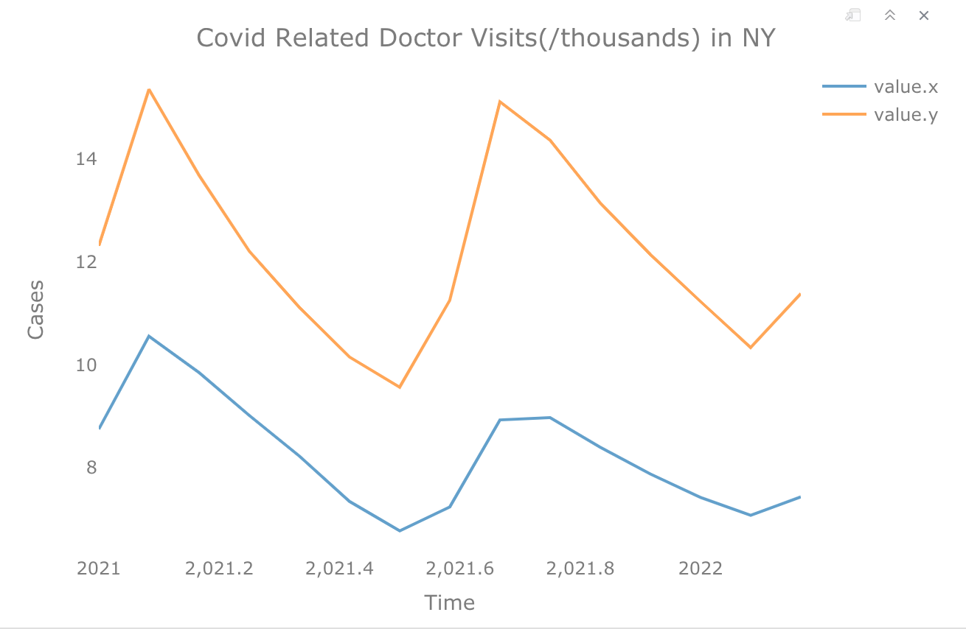
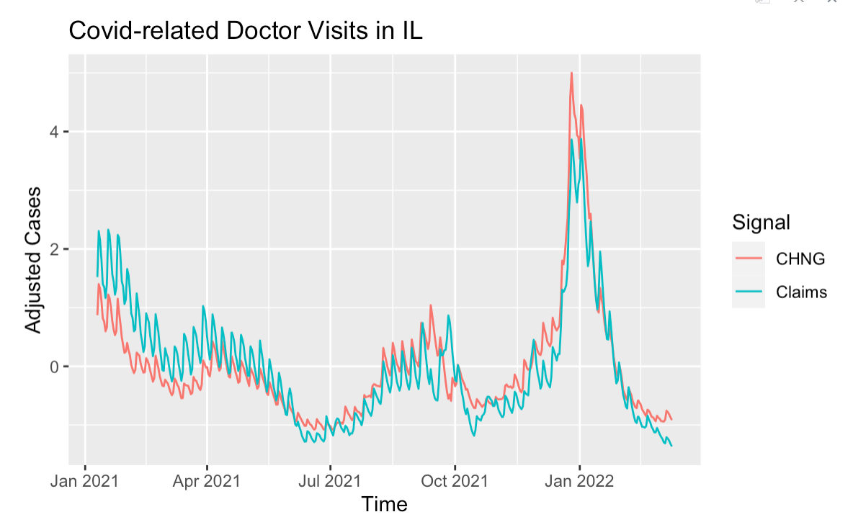
Overall Trend: Covid-Related Visits from Change Healthcare and Claims (2021-2022)
Data: 2021.01-now |Six States| Red line: CHNG- Change Healthcare, Blue line: Doctor Visits | Generally don’t agree much

Slide 23
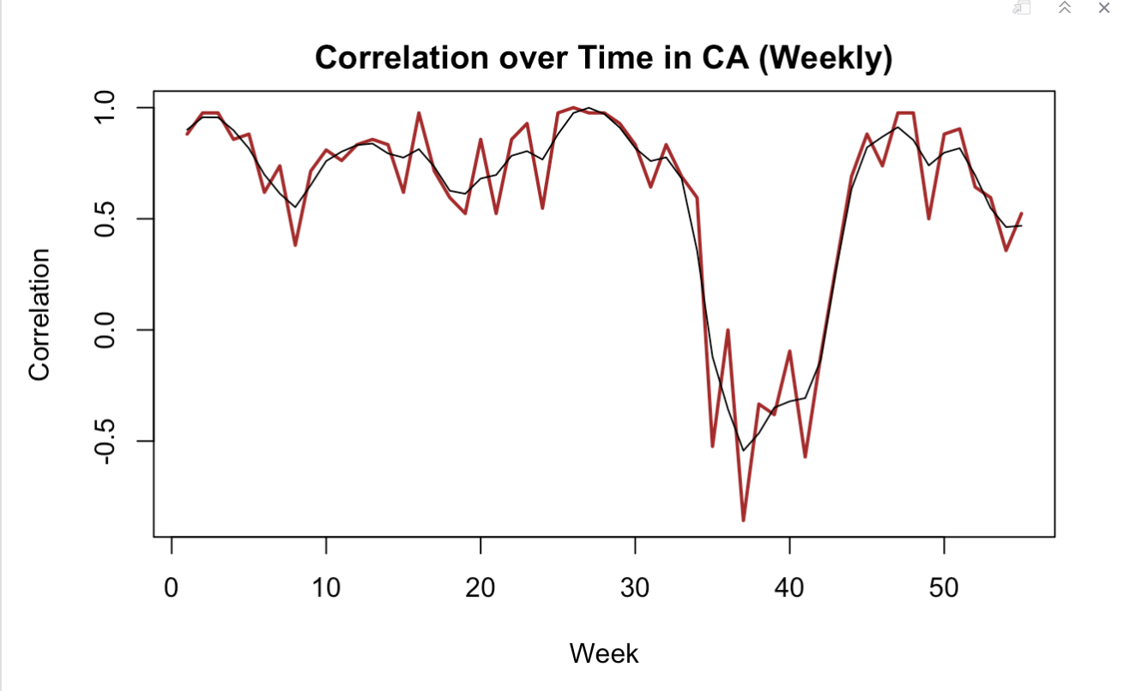
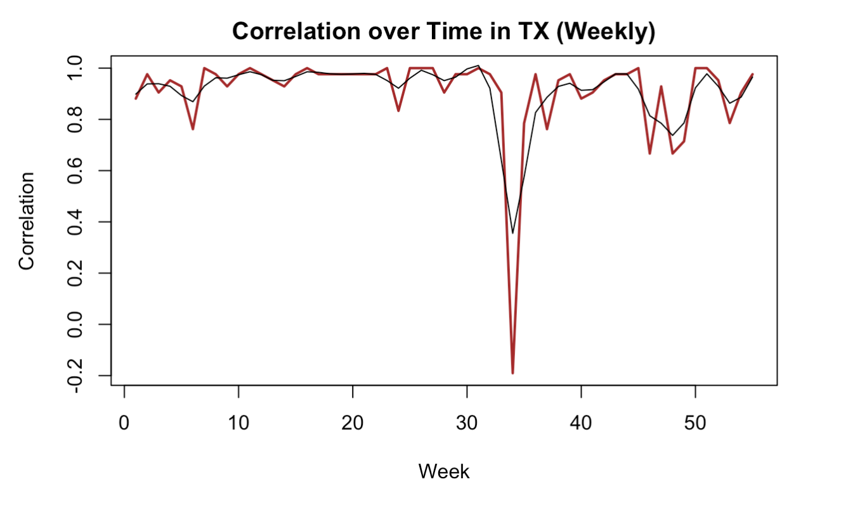
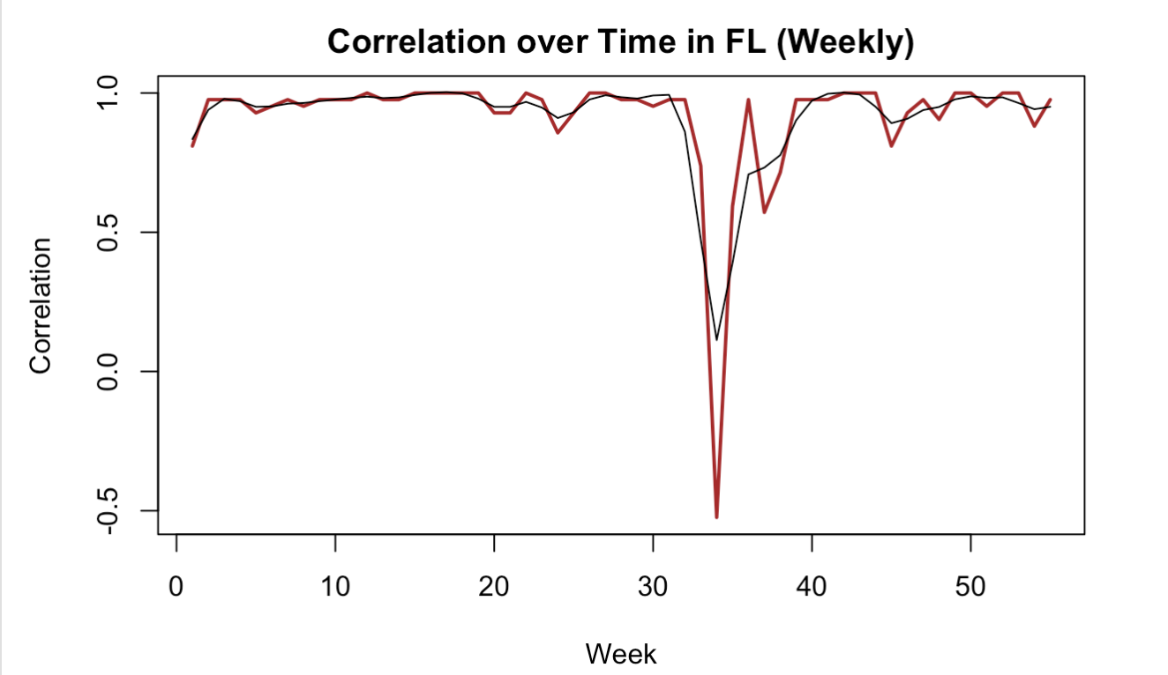
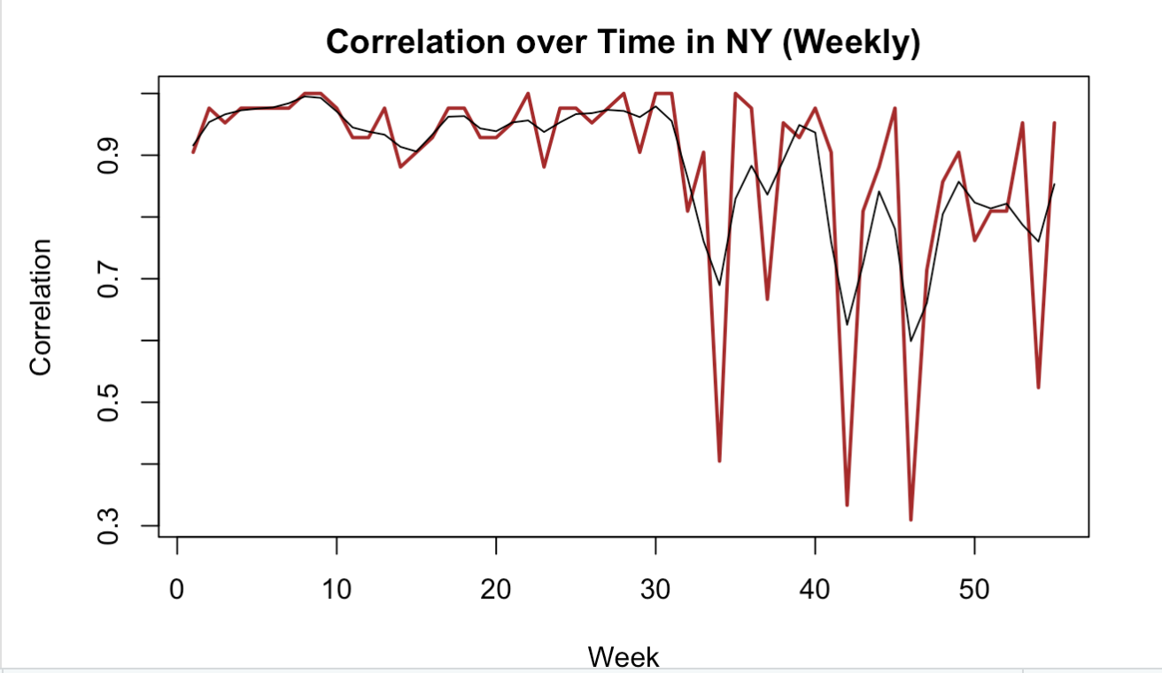
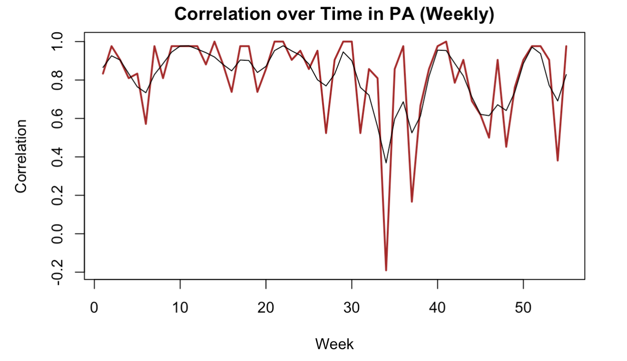

Correlation over Time: Covid-Related Visits from Change Healthcare and Claims (Weekly)
Correlations across months starting 2020.1
Weekly segment:
Low correlations: between 30-40 weeks

Slide 24



Additional Investigation in Counties: Covid-Related Visits from Change Healthcare and Claims
County Population density
Choose counties that have deeper/lighter colors to look at doctor visits
Could fail because of county-merged data

Slide 25
Thank You

